Slide 1
26th Meeting of the Wiesbaden Group on Business Registers
TOOP: The Once Only Principle Project
Prof. Dr. Alessia C. Neuroni
Neuchâtel, 27 September 2018
Notes:
Obiettivo principale della presentazione
Présenter le programme de Only once principle (TOOP). La spécificité de l’initiative, qui n’est pas au principe une émanation administrative et les projets pilotes.
Ulteriori aspetti da tener conto nella preparazione dell’intervento
La construction du registre des groupes, le traitement de l’échange d’information sur les groupes transnationaux, la possibilité de collecter l’information une seule fois pour plusieurs buts, la diminution de la charge. Comment les registres statistiques peuvent participer à ce programme ? Bénéfices et avantages dans la participation à ce programme.
How we can apply it cross-boarder
Common taxonomy
International standards

Slide 2
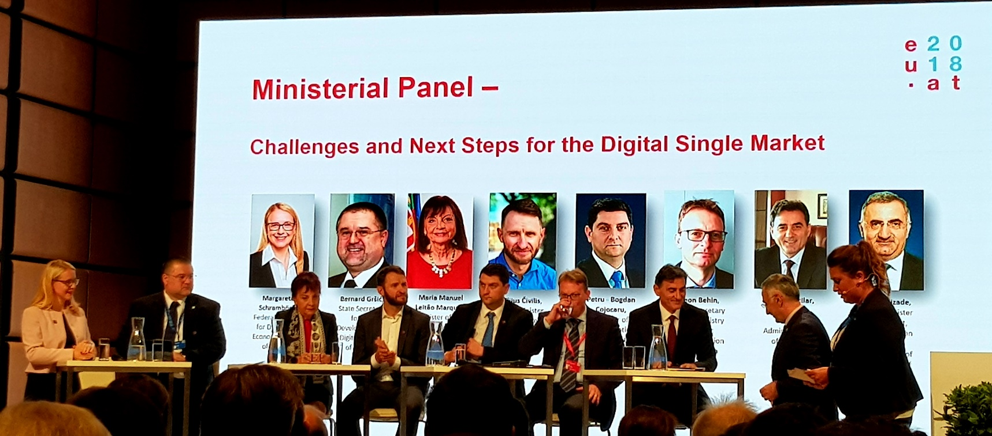
High Level Conference on Digital &
E-Government, Vienna 26 September 2018
Notes:
Over the last years, the European Union has promoted open, transparent and collaborative governments designed around digital delivery of public goods. The aim is simple: We want to make life easier for our citizens and businesses. We see a model of governance without barriers, which encourages citizens and community to get involved, and administrations to interact with each other, and with civil society, businesses and citizens across Europe. The Tallinn declaration signed by all EU governments is an unparalleled marker of this joint commitment.

Slide 3
“The industrial revolution of our time is digital. … As companies aim to scale up across the Single Market, public e-services should also meet today’s needs: be digital, open and cross-border by design. The EU is the right scale for the digital times.”
Andrus Ansip, Commission Vice-President for
the Digital Single Market
Notes:
The Digital Single Market strategy aims to open up digital opportunities for people and business and enhance Europe's position as a world leader in the digital economy

Slide 4
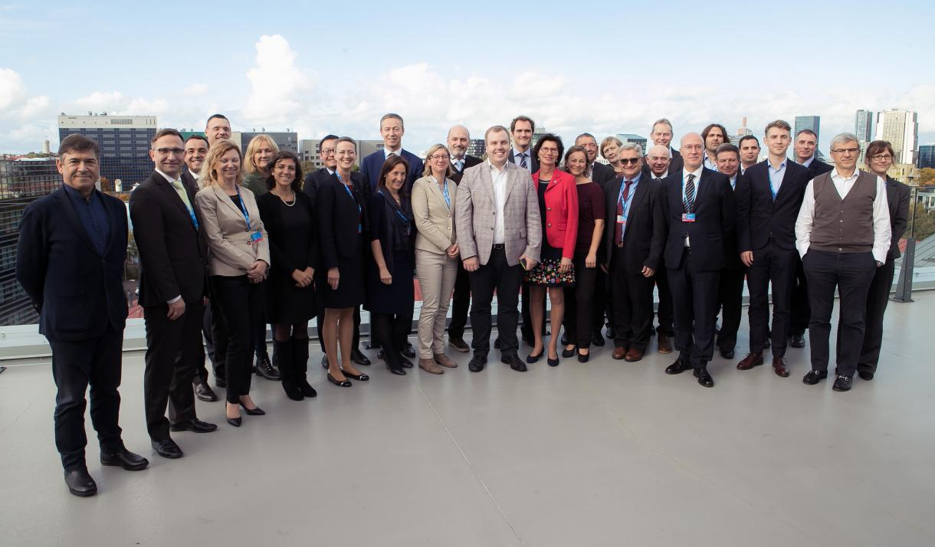
Tallinn Declaration
Digital-by-default, inclusiveness and accessibility
Once only
Trustworthiness and Security
Openness and transparency
Interoperability by default
Horizontal enabling policy steps
Notes:
All the European Union Member States and EFTA countries signed the 'eGovernement Declaration' in Tallin on 6 October 2017.
User centricity – reach them by 2020
How we will measure our success?

Slide 5
Once Only Principle: A Definition
Collecting & storing data only once
Streamlining processes by:
Enabling automated data sharing
Replacing redundant data collection with information requests from original source
Improving data reliability.
Notes:
Our view in the project is not to have the data owner submit / provide the information twice.
The main goal is to avoid the submission of information that already exists – and so avoid the administration burden of providing it.

Slide 6
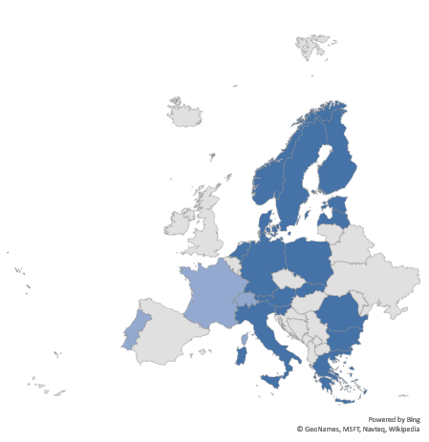
Key facts about TOOP
Project duration:
January 2017 – June 2019
Participants:
21 beneficiaries from 21 countries
Altogether 50 partners:
Public administrations;
Universities;
Companies.
Coordinator:
Tallinn University of Technology, Estonia

Slide 7
TOOP aims to
Provide time savings for PAs and businesses;
Lower administrative burdens and costs;
Improve service quality and public sector efficiency;
Comply with data protection legislation;
Ensure security, interoperability, data quality, user-friendliness.
Support a better functioning Digital Single Market.
Notes:
TOOP aims to explore and demonstrate the implementation of the once-only principle across borders through multiple sustainable pilots, focusing on data from business.
→ Develop an architecture that enables better exchange of data or documents of businesses with and between public administrations

Slide 8



TOOP Pilot Scenarios
Cross-border e-services for business mobility
Updating connected company data
Online Ship and Crew Certificates
2 baseline scenarios: data pull and data push
Notes:
e-services for business mobility:
e-procurement - automatic retrieval of qualification evidences, but also of business data for those of you who are familiar with the european single procurement document, which is mandatory and becoming electronic now. That is a once only case that we hope to be implemented through TOOP;
licenses and permissions: typical examples of business mobility based on the services directive;
mandates and powers of representation, which are important for any business mobility scenario.
business registers pilot - connecting company data
business registers providing data to external egovernment applications and to each other. now we are working towards having a connection to BRIS.
Maritime pilot:
providing ship and crew certificates;
currently a largely manual process;
The architecture, the infrastructure and the components that we are building, they have to work for the SDGR, so also for the citizens use cases.
We are looking now at SDGR-specific procedures in order to understand whether there are procedure-specific requirements that would require fine-tuning of the architecture, so that it fits them as well.

Slide 9
Updating connected company data
Business registers (BR) pilot
Business registers providing data to external E-Gov applications and to each other cross-border.
Now we are working towards having a connection to the Business Registers Interconnection System (BRIS).
Notes:
Exchange of data – machine to machine. Endpoint of the data → consumer and on the other end data provider. Store only once it is not our focus.
(national approaches)
Provide the federated architecture → to be able to retrieve it automatically.

Slide 10

Basic concepts and OOP needs – bilateral connections
DATA
CONSUMERS
eGov eService
eGov eService
eGov eService
eGov eService
DATA
PROVIDERS
DOMAIN-SPECIFIC
DATA PROVIDERS
GENERAL-PURPOSE
BASE REGISTERS
BUSINESS REGISTER

Slide 11
Partial OOP implementation –
Data Aggregators
DATA
CONSUMERS
eGov eService
eGov eService
eGov eService
eGov eService
National
Data Aggregators
DATA
PROVIDERS
DOMAIN-SPECIFIC
DATA PROVIDERS
GENERAL-PURPOSE
BASE REGISTERS
BUSINESS REGISTER

Slide 12
The Once-Only Layer at a national level
DATA
CONSUMERS
eGov eService
eGov eService
eGov eService
eGov eService
National OOP Layer
DATA
PROVIDERS
DOMAIN-SPECIFIC
DATA PROVIDERS
GENERAL-PURPOSE
BASE REGISTERS
BUSINESS REGISTER

Slide 13
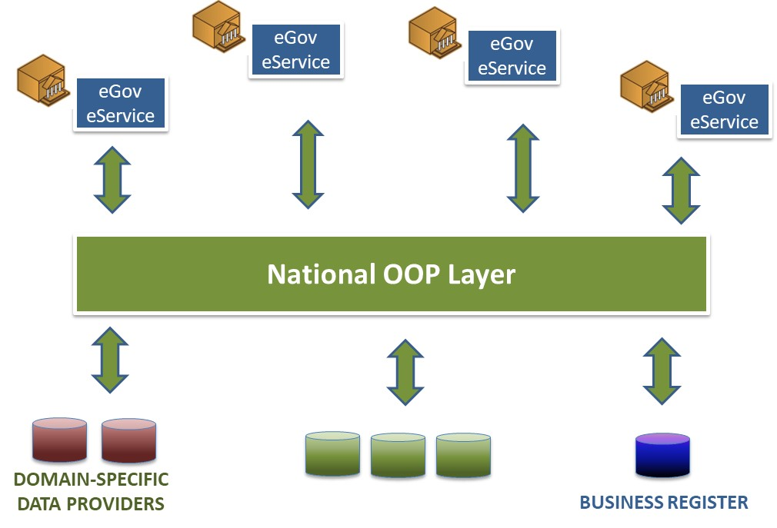
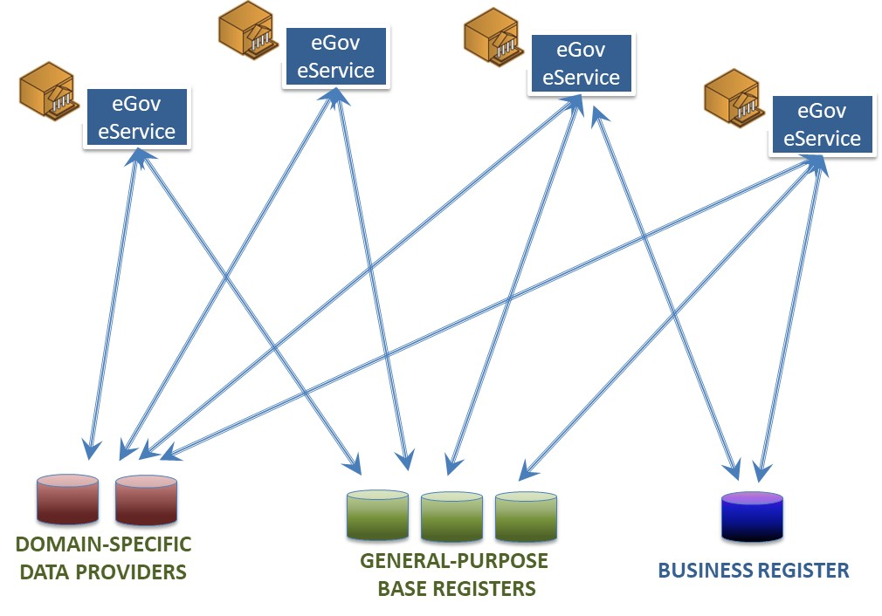
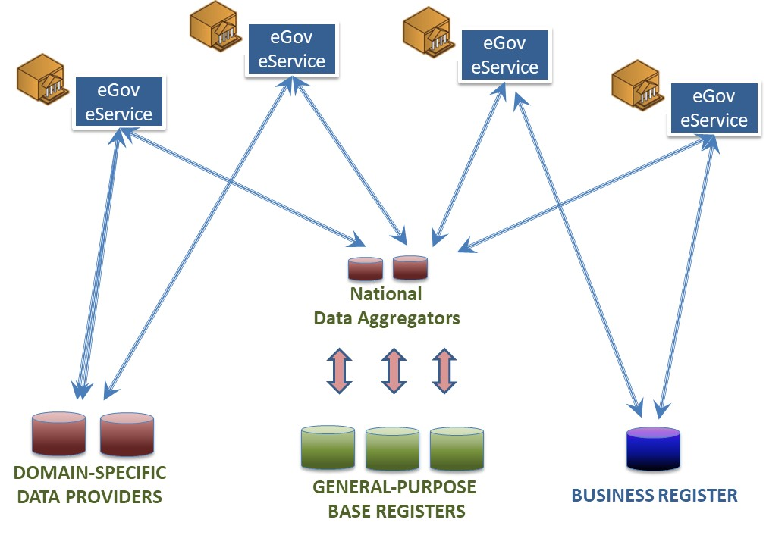
Cross-Border Once-Only
TOOP Federation:
Acts as a Cross-Border
Once-Only Layer

Slide 14
How TOOP fits into the big picture
BUSINESS REGISTRIES
AS DATA CONSUMERS
Any eService
As Data Consumer
National Data
Aggregators
DOMAIN-SPECIFIC
DATA CONSUMERS
National OOP Layer
BRIS
DOMAIN
FEDERATION
(EESSI, Tax,
PEPPOL
etc.)
TOOP Federation
of Federations
National OOP Layer
National Data
Aggregators
DOMAIN-SPECIFIC
DATA PROVIDERS
/AGGREGATORS
GENERAL-PURPOSE
DATA SOURCES
BUSINESS REGISTRIES
AS DATA PROVIDERS
Notes:
Complicated, but real view.
How TOOP will link to BRIS?
We provide the facilities→ pull of data (slide in)
Building blocks → reusing eu-infrastructure (slide in)
Of course we need semantic mapping (for the different countries) → harmonizing will not work.
Business mobility → activity across countries.
Greece and Sweden already exchange data
What’s changing? Speed up the national level -> it makes easier to adopt it cross-border.
SEMANTIC MAPPING

Slide 15
Example 1: eGov Service to any Base Registers cross-border
Any eService
As Data Consumer
National OOP Layer
TOOP Federation
of Federations
National OOP Layer
National Data
Aggregators
GENERAL-PURPOSE
DATA SOURCES

Slide 16
Example 2a: eGov Service to Business Register cross-border
Any eService
As Data Consumer
National OOP Layer
BRIS
TOOP Federation
of Federations
National OOP Layer
BUSINESS REGISTRIES
AS DATA PROVIDERS

Slide 17
Example 2b: eGov Service to Business Register cross-border
Any eService
As Data Consumer
National OOP Layer
BRIS
TOOP Federation
of Federations
National OOP Layer
BUSINESS REGISTRIES
AS DATA PROVIDERS

Slide 18

Baseline Scenario: Simple pull of data
DATA CONSUMER
DATA PROVIDER
Identification
TOOP
Determine Data Requirements
Discover
Publish
Data Provider Capability
Ensure Consent
Prepare Data Request
Send
Receive
Process Data Request
Data Request
VIEW & ACCEPT
Transform Data
Map Semantics
Transform Data
VIEW & ACCEPT
Process Data Response
Receive
Send
Prepare Data Response
Data Response

Slide 19

Extended Scenario: Notify & push
DATA CONSUMER
Map Semantics
DATA PROVIDER
Aware of EO
Translate Data
Ensure Consent
TOOP
Subscribe
Publish
Event: EO Data Change
Notification Capability
Process Notification
Receive
Broadcast
Prepare Notification
Data Change Notification
Decision to accept Data
Send
Receive
Process Acceptance
Data Change Acceptance
Process Data Update
Receive
Send
Prepare Data Update
Data Update

Slide 20

Re-using and extending cross-border EU infrastructure
DATA CONSUMER
DATA PROVIDER
Identify EO
Ensure Consent
TOOP
CEF, ISA
Request EO Attributes
eIDAS infrastructure
Provide EO Attributes
Additional Attribute Discovery, Mandates modelling etc.
Semantic mapping (e.g. eCertis)
Request Company Data
eDelivery infrastructure
Provide Company Data
OO profiling of Message Exchange, Dynamic Discovery etc.

Slide 21
Pilot Areas, countries and status
eProcurement
  DE, FR, GR, IT, PT
General Business Mobility (eGov-to-BusinessRegisters)
  AT, EE, GR, IT, NL, NO, PL, RO, SE, SI, SK
  Licenses, permissions, mandates, company data
  Cooperation with BRIS
  Can enhance BR-to-BR connection
Online Ship and Crew Certificates
  BG, DK, EE, GR, LV, NO
GR – SE ALREADY CONNECTED.
COME JOIN US, TO LEARN AND PILOT!
Notes:
Working in an agile way;
First version of TOOP common components released in May;
Implementation of TOOP software components;
TOOP pilots will be ready to test data exchange via TOOP infrastructure in autumn 2018;
Sweden and Greece - the first active implementation:
Greek ESPD service deployed with data consumer capability;
Swedish Business Register deployed as data provider and data consumer.
Working on extending the use cases in alignment with SDGR.

Slide 22
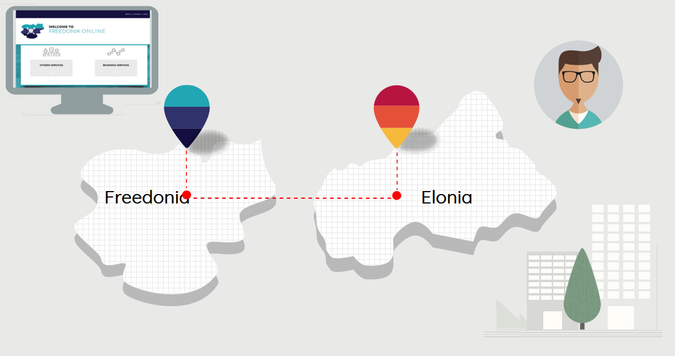
A TOOP-enabled service demo
Maximillian, an Elonian entrepreneur, wants to expand his business to Freedonia. He goes to Freedonia's Single Digital Gateway for help …
https://egovlab.eu/toop-panorama/
http://193.10.8.213/ui?restartApplication
Notes:
Presenting the way that the TOOP architecture components work together to provide automated data exchange across borders

Slide 23
Thank you for your attention!
Want to know more? www.toop.eu
Twitter: @toop4eu
Facebook: www.facebook.com/onceonlyprinciple

