Slide 1
Wiesbaden Group Neuchatel 24 – 27 September 2018
Session No. 6:
Profiling and Globalisation
Caisa Bergman, Advisor at Coordination and Analysis
Richard Nilsson, Advisor at National BR
Department for Economic Statistics
Statistics Sweden

Slide 2
Why profiling?
The structures of large enterprises are often very complex. Statistics based on legal units tends therefore to be a bit misleading.

Slide 3
Council Regulation 969/93 on statistical units
“The enterprise is the smallest combination of legal units that is an organizational unit producing goods or services, which benefits from a certain degree of autonomy in decision-making, especially for the allocation of its current resources. An enterprise carries out one or more activities at one or more locations. An enterprise may be a sole legal unit.”

Slide 4
Size of profiling problem

Slide 5
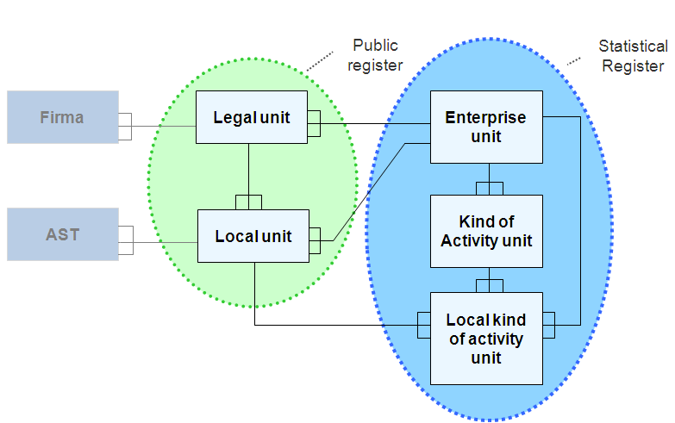
Units in the Swedish Business Register

Slide 6
The Units in the SBR
All Legal Units/Natural persons
Corporate identity number = Organisation Registration Number
Personal ID-number
Local Units
Every Address, Estate or group of Estates where an economic activity is carried out
Enterprise
Corresponds to One legal unit
or
The smallest combination of legal units
Enterprise Group
Domestic or multinational
KAU - Groups all the parts of an Enterprise contributing to the performance of an activity at class level (4 digits) of NACE Rev.2.
LKAU - The geographical breakdown of a Kind-of-Activity unit
Notes:
The Swedish Tax Agency is our main source and SBR is updated every week.
Information on new, dormant and cessed legal units.
Information on changes in contact variables or in activity code.
This is the information that is changed/updated every week from NTB.
ID-number on new legal units
Legal person – Organization number
Natural person – Personal identification number
Changes or update on
Name, Address, Tel No
Legal form, Activity code, Regional codes
Registered for VAT, PAYE, Business tax – our activity criteria

Slide 7
The profiling process in 5 steps
1. Automatically create:
1.1 Population
1.2 Automatic profiling ENT
1.3 Identify candidates for KAU:s
2. Automatic control systems:
2.1 Controlling the structures
2.2 Comparisons to current units
2.3 Complexity calculation
3. Manual handling and validation:
3.1 Manual profiling
3.2 Validation
3.3 Reporting units
4. Implementation
5. Adaption

Slide 8
Information retrieved from BR and KCR
The Swedish Group Register (KCR) contains all Group LEUs. The information is retrieved from annual reports and reflects the date of the closing date of the fiscal year. The profiling is based on the ownership conditions of the KCR.
A Local Unit is coded in the Business Register as auxiliary unit if it serves other activities, i.e. the producing unit

Slide 9
Example
A Swedish Business Group with 66 active Legal units: Situation today: 66 Enterprises, and the largest Enterprise is divided in two KAU:s
After profiling: 14 Enterprises, 2 divided in 2 KAU:s each
Auxiliary activities (administration, trade with own products, personnel etc.) is included in the Enterprise they serve
Most of the real estate enterprises are put together in the same Enterprise (30 Legal units)

Slide 10
Issues
..or should the whole Swedish part of the business group be considered as one Enterprise?
We have chosen to see Legal units who functions independent within the business group as Enterprises together with eventual auxiliary activities.
Remains: organise a meeting with the enterprise where we will present our plan and see if they think this will give a better picture of the structure of the Swedish part of the business group. We will also ask them to try to report consolidated figures. In most cases we will have to do the consolidation ourselves since the companies normally only have data on Legal units.

Slide 11
Surveys affected
Which surveys are affected the profiling work:
SBS and Business Demography
Foreign affiliates statistics – FATS
Community Innovation Survey
Research and development in the business enterprise sector
Global Value Chains?
All surveys that uses KAU as statistical unit are also affected (most short term statistics)

Slide 12
Effects on the statistics
How is the statistics affected?
The number of enterprises decreases
We get a better picture of size classes and industries
Less inflated values (for example: net turnover, production value)
Industries where auxiliary activities are common will decrease in size
Breaks in time series

Slide 13
Other issues
Effect on the production process at Statistics Sweden
The Reporting object will not always be the target object
Models for distribution values to the statistical unit will have to be used
We have to develop a data system that can be used to create statistical units
Initially an extensive task of introducing all new statistical units into the Business Register…
…but the continuous work in may not need to be so much more extensive

Slide 14
Effects on the work methods
The enterprises will probably not be able to report data on the Enterprise level – we will have to consolidate the data on Legal unit level to obtain data on Enterprise level
The work load will increase since profiling and consolidation activities is time consuming

Slide 15
Thank you for your attention!
Contact information:
caisa.bergman@scb.se
richard.nilsson@scb.se

