Slide 1
The OECD Analytical Database on Individual Multinationals and Affiliates (ADIMA)
SESSION 5
Diana Doyle, Fabienne Fortanier, Graham Pilgrim
OECD Statistics and Data Directorate
26th Meeting of the Wiesbaden Group
on Business Registers
Neuchâtel, 24-27 September 2018

Slide 2
Measuring Multinationals
Multinational enterprises (MNEs), driving the international fragmentation of production, play an increasingly important role in national economies…
…inducing a growing demand for improved statistics on the scale and scope of their activities, and timely information on restructurings they may undertake
  Also in light of the statistical implications of these restructurings, e.g. Irish GDP
However, statistical information on MNEs remains at best patchy, due to:
  Complexity of MNE international activities (partly also by design),
  Legal restrictions for NSOs and CBs on obtaining information outside their jurisdiction, and in sharing data (inter)nationally
…generating ample scope for inconsistencies and asymmetries in MNE data (and so, core macroeconomic statistics such as GDP) across countries

Slide 3
The OECD ADIMA database
The OECD Analytical Database on Individual Multinationals and their Affiliates (ADIMA) provides information on the scale and scope of international activities of MNEs, taking a ‘whole of the MNE’ view, to support analytical and policy work on MNEs and the improvement of national statistics
ADIMA involves the development of:
  a Register of MNE parent-affiliate structures;
  a series of Economic Indicators at both the level of the MNE and the individual countries in which it operates;
  and a Monitoring tool that aims to provide a timely flow of information on MNEs restructurings to aid the work of national compilers
ADIMA explicitly aims to build on, and complement, existing national and international efforts in a collaborative fashion:
  Eurostat’s EuroGroups Register (EGR) and Early Warning System (EWS)
  Global Legal Entity Identifier Foundation (GLEIF)
  Aid profiling work of National statisticians, e.g. in Large Cases Units

Slide 4
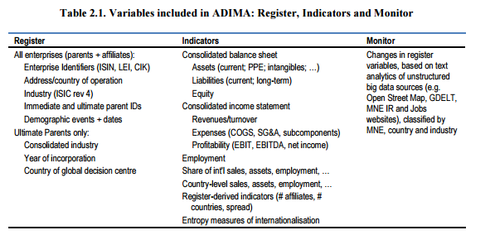
Structure of ADIMA
Notes:
The foundation of the ADIMA is formed by a register of MNE Parent-Affiliate structure. This dataset includes, for each parent MNE and all its affiliates, a variety of

Slide 5
Methodological approach
  Combination of traditional data sources with newly emerging sources and innovative ‘Big Data’ analytics, e.g.
    Traditional sources + innovative methods: XBRL-assisted scraping of company Annual Reports overcomes previous challenge of not being machine-readable
    Emerging sources: Legal Entity Identifier (LEI)
    Innovative sources + innovative methods: web-scraping MNE websites paired with NLP text analytics
  Careful validations and alignment with official statistical concepts
  Hence: results are timely, scalable, and can be publicly disseminated

Slide 6
ADIMA MNE Coverage
Target for end-2020: 500 largest MNEs globally
Target for end-2018: 100 largest MNEs globally
Current ‘proof of concept’ sample: 37 US MNEs (from the 100 for 2018)
Selection criteria:
  Revenues. Companies were selected (top down) from the top largest enterprises globally, ranked by total revenues for 2016.
  Stock listing. Publicly available Financial Reports and Accounts are a vital data source for ADIMA. Therefore, a listing on a stock exchange was considered a pre-requisite for enterprises to be included.
  Multinational. Considering the focus of the project, only enterprises that met the internationally accepted definition of being a multinational were selected – i.e. to have an operating affiliate in at least one country outside the enterprise’s home country.

Slide 7
Next steps
Expand towards 100 MNEs end 2018 & 500 MNEs end 2020
Refine existing methods /sources
Continue exploration of new data sources to develop geographical breakdowns of additional indicators
  assets and employment as first priorities
  E.g. Social media, Open Street Map, news services such as GDELT (global news), job vacancy websites, MNE server security certification...
Further validation of the data, including in collaboration with countries and Eurostat
Development of the Monitoring Tool
  In alignment with and complementary to Eurostat EWS
  With pilot tests with interested countries

Slide 8
Thank you!
For questions or comments, please contact
  Diana Doyle, Diana.Doyle@oecd.org
  Fabienne Fortanier, Fabienne.Fortanier@oecd.org
  Graham Pilgrim, Graham.Pilgrim@oecd.org

