Slide 1
Statistical Business Registers Rico Konen (NL)
Wiesbadengroup 2018, Neuchâtel (CH)

Slide 2
Globalisation in business statistics
Globalisation in business statistics is the existence of interactions between enterprises residing in different countries.

Slide 3
Inward FATS & Outward FATS
Inward FATS indicators describe the production factors generated by foreign ‘investors’ in a domestic economy. For IFATS the country of the (foreign) GDC/UCI for each domestic enterprise is needed to compile the IFATS-indicators.
Outward FATS indicators describe the production factors generated by domestic ‘investors’ in a foreign economy. For OFATS, the GDC/UCI could be surveyed to obtain information about those affiliates, that reside outside of the EU. This implies that the national identification of the (domestic) GDC/UCI is known.

Slide 4
FATS Statistics
Domestic Control
Foreign Control
UCI
% of ENT

Slide 5
FATS Statistics
GDC/UCI
Global Decision Center (Ultimate Controlling Institutional Unit)
General Policy
Appoint directors
Suggest Investments
Share Profits
NL
E1
BE
E2
Data collection
The aggregated value of the production factors collected with the UCI in the Outward FATS should be the same when grossing up the single values of the production factors collected with all ‘affiliates’ in the Inward FATS.
FR
E3
DE
E4
CN
E5

Slide 6
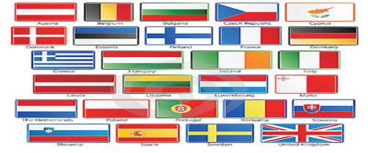
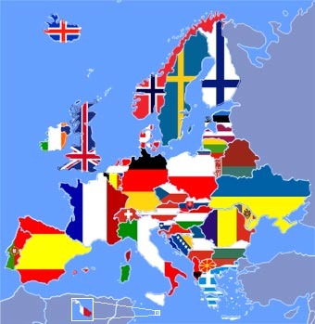
EuroGroups Register (EGR)
Data-Import (EU-States)
LEU REL ENT LEL
LEUREL
Data-Import
(Commercial Data Providers)
GEG
EGR
CLUSTER OF CONTROL
Retrieve
Data
!

Slide 7
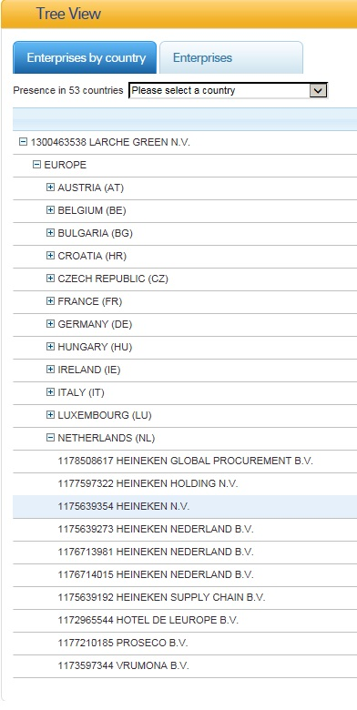
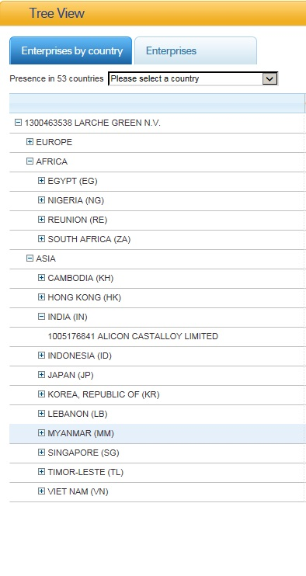
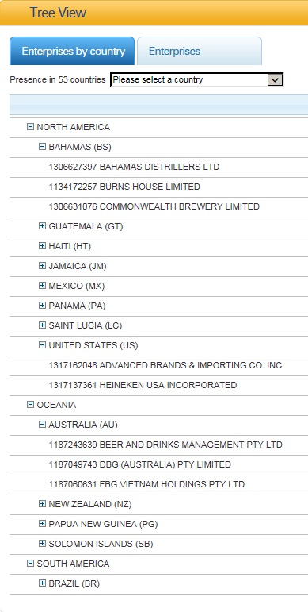
EuroGroups Register (EGR)

Slide 8
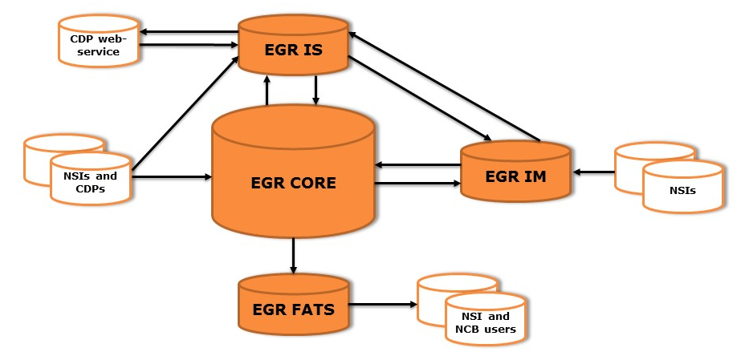
EuroGroups Register (EGR)
EGR IS | Identifying legal units globally by a Legal Entity Identifier (LEID).
EGR CORE | Input data of different sources is stored, transformed and consolidated and EGR frames derived.
EGR IM | Interactive web interface to browse, validate and update data in the live area of EGR CORE
EGR FATS | Application providing users a web interface to browse and download coordinated EGR frames

Slide 9
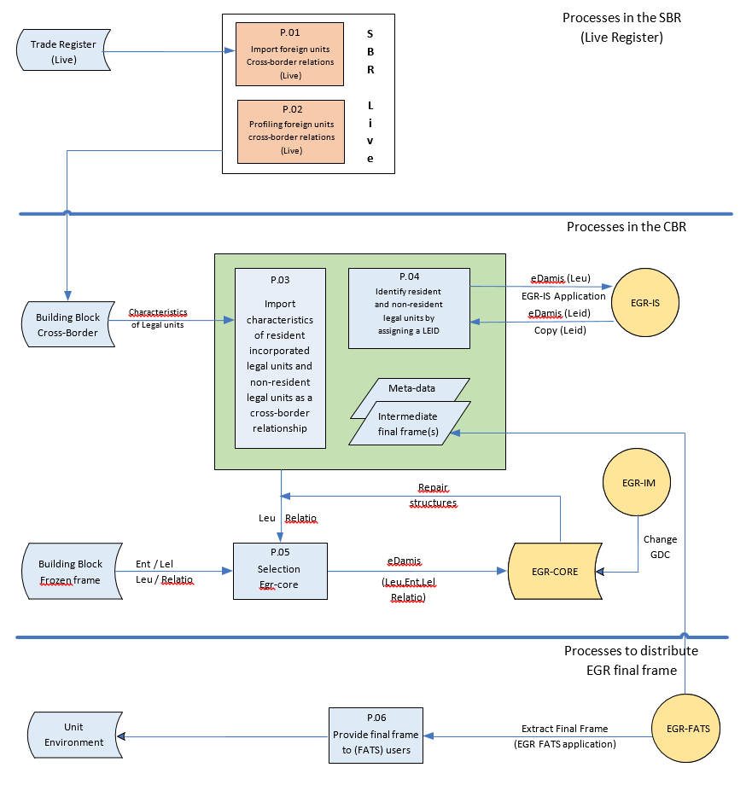
Cross-Border Register (CBR)

Slide 10
EGR-quality issue for Dutch IFATS
UCI1
(CA)
UCI2
(NL)
Missing link?
Legislation?
GGH1
(NL)
GGH2
(GB)
LEU1
(DE)
LEU4
(DK)
LEU2
(SP)
LEU3
(BE)
LEU5
(FR)
LEU6
(BG)
Notes:
Research on the structure of the enterprise group gives information about the legal units and their legal names. The legal name often comprises foreign phrases of the original country where the ‘GDC’ is located (Like Siemens Luxembourg S.A.R.L.). Googling the name of an arbitrary subsidiary often leads to https://opencorporates.com/. This website provides information about the organization and the structure of many GEGs, including the link to the company’s website. It often occurs that a GDC outside of Europe will open a corporate as a Luxembourgian Limited, recognized with the wording ‘SARL’ in its legal name. The corporate structures of American GEGs are often reported on https://www.sec.gov/ or https://www.bloomberg.com/europe. American GEGs often establish a legal entity in Ireland (IE) to support their activities in Europe.
According to Dutch law, a board member of an incorporated enterprise might be held responsible for his or her policy when the business cannot fulfil its obligations regarding the payments of taxes and contributions as a consequence of mismanagement. Therefore some leading board members will establish an official legal holding entity in England to by-pass this risk. These entities can often be recognized by the addition ‘Limited (LTD)’ in their legal name. In these cases it is not likely that the country of the GDC is the UK, but NL. Googling the name of this particular board member often results in a Dutch home address, which more or less proves that the board member operates from NL. See Dutch law about “Bestuurdersaansprakelijkheid”: https://www.belastingdienst.nl/wps/wcm/connect/bldcontentnl/belastingdienst/zakelijk/aangifte_betalen_en_toezicht/aansprakelijkheid/bestuurdersaansprakelijkheid/

Slide 11
Future plans
Optimize collaboration between the SBR and the EGR by adding new or improving the features of the CBR
Improve the quality of the EGR-information by intensifying the use of the EGR applications, like the EGR-IM
Support IFATS Statisticians to detect the country of the GDC by using Web Scraping and Graph Databases.

