Slide 1
Outputs of the Montenegrin Statistical Business Register
By Marijana Popovic-Roncevic, MSc.
Free Powerpoint Templates

Slide 2
Content :
Introduction
The sources of the statistical business register maintenance
The users of Statistical Business Register data
Outputs of the Montenegrin Statistical Business Register

Slide 3
Introduction:
Statistical Business Register of Statistical Office of Montenegro was created in early year 2007.
A few years ago, Statistical Business Register has served only as directory for finding a list of legal and statistical units and their addresses.
Today, we have, as a main goal, the tendency that Statistical Business Register be a backbone in the production of economic statistics.
Statistical business register is a live register in which the composition and characteristics of units continuously change over time.

Slide 4
Continuation:
Statistical business register is composed of two parts: the administrative and statistical part.
The administrative section consists of legal units ;
Statistical section consists of statistical units such as: Enterprise (the biggest number of cases in BR are where is legal unit = enterprise but lately we had more cases where is more than one legal unit create an enterprise); local units; KAU units and Enterprise Group.
There is always a consistency between these two parts of the registry. Administrative sources and different statistical surveys are used for updating this register. Statistical Business Register provides the link between administrative data inputs and statistical data outputs.

Slide 5
Continuation:
All data changes along with the date changes and data sources are stored in the historical database tables in the statistical business register.
The impact of globalization imposes more extensive coverage of statistical units and their coverage.
For years, there is a growing need for a geospatial analysis. The geospatial information needs to be updated regularly.

Slide 6
The sources of the statistical business register maintenance
Maintenance of statistical business register is not a single process. It is continuous activity. The frequency of the register maintenance is a crucial point in the timeliness of the register.
The register sources can be administrative registers, register surveys, feedbacks from survey results and other sources.
In Montenegro the registration is operated by a so called “one-window” system

Slide 7
Continuation:
The main sources of the statistical registers are the administrative sources.
Second source for maintaining of Business register are business register surveys.
We have three regular BR surveys.
Very important source for maintenance of business register are feedbacks from statistical surveys.

Slide 8
The users of Statistical Business Register data
Different types of users who need different statistical data for different purposes define different needs for statistical data.
We can divided users on the internal and external users.
The external users of Statistical Business Register data can generally be divided into seven groups: government institutions, local government units, NGOs, research centers national and international), international organizations and embassies, financial institutions, enterprises, associations, chambers and the public (media, educational institutions and citizens).
Internal users are all statistical surveys.

Slide 9
Outputs of the Montenegrin Statistical Business Register
The basic products of dissemination of statistical data are printed and electronic publications, statistical data organized in databases that are available on the website, or internally within the databases available to the statisticians.
MONSTAT is aware of the obligation to present statistics to the public in a systematized and classified manner.
The main role of the SBR is that it represents a base used to carry out statistical surveys. As each year, its significance grew, so more and more outputs began to grow.
For years, from our Statistical Business Register produced outputs for the purpose of satisfying different user needs.

Slide 10
Continuation:
One of the most important outputs of SBR is a frozen frame produced at the end of each year which is using by all statistical surveys.
From the Statistical Business Register we have outputs, which are available through publication: Number and structure of business entities in Montenegro, (in March of the current year for the previous year); Number and structure of enterprises which has foreign owners, (in July of the current year for the previous year).
We publish from the Statistical Business Register, release about newborn and inactive enterprises.

Slide 11
Continuation:
In previous years, driven by the demand of users, we published data on owners of active enterprises, observed by gender.

Slide 12
Continuation:
In order to comply with international standards, MONSTAT insists that the entire process of organizing, collecting, processing and disseminating data be accompanied by clearly defined procedures adopted at MONSTAT level.
We made the Dissemination Strategy .
The goal of the Dissemination Strategy is to make the statistics available to all users in a comprehensible manner at the same time and under the same conditions.

Slide 13
Continuation:
The dissemination policy in MONSTAT is implemented through five strategic objectives:
1. Creating a demand for MONSTAT data (recognition and image)
2. Continuous availability of data
3. Clarity of data
4. Data distribution channels
5. Communication with users / User type and type of needs.

Slide 14
Continuation:
Distribution Channels are:
• WEB site
• E-mail, telephone and mail
• Information line
• Publications and Communications
• Combined distribution channels
• The library

Slide 15
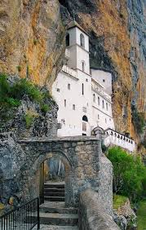
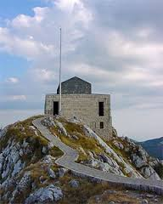
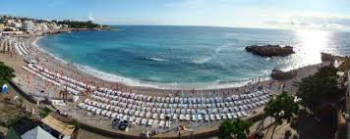
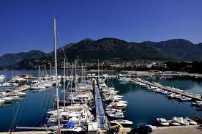
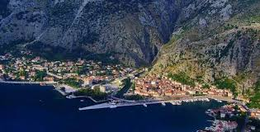
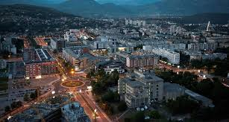
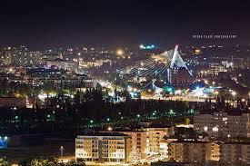
MONTENEGRO

Slide 16
Thank You !
e-mail: marijana.popovic@monstat.org
www.monstat.org

