Slide 1
Basic Statistics on Korean SMEs
- 26th Meeting of the Wiesbaden Group on Business Registers -
Neuchâtel, 27 September 2018
KIM, Bokyoung

Slide 2
Contents
Introduction
Status of Korean SMEs
Implementation of SMEs statistics
SBR in Korea
SMEs Statistics Using SBR
Q&A

Slide 3
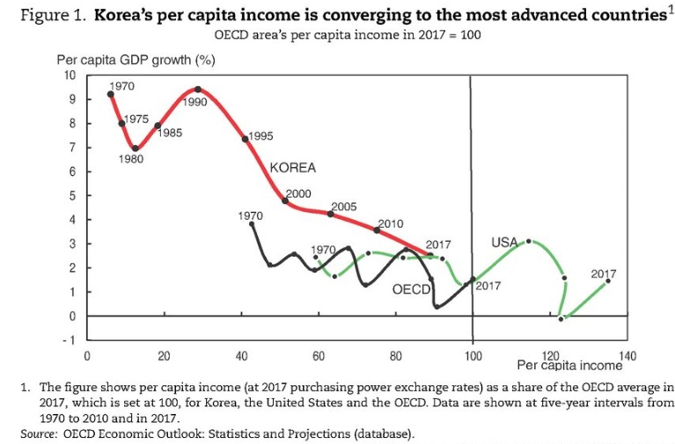
Introduction

Slide 4
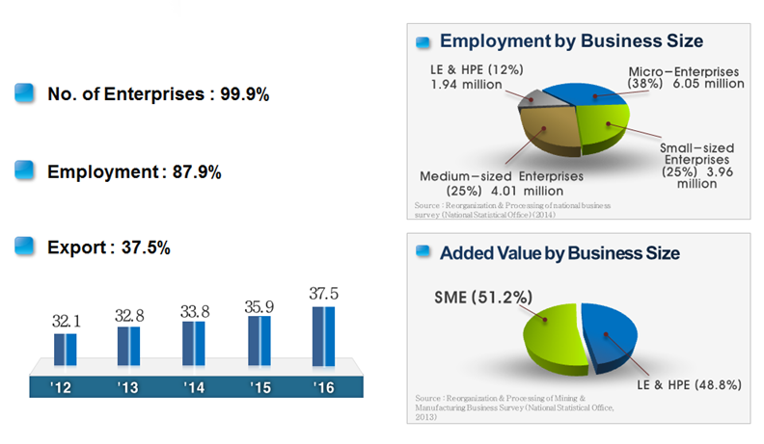
Status of Korean SMEs

Slide 5
Implementation of Korean SMEs statistics
Statistical Units: Establishment (Local unit) → Enterprises
Data Sources: Census on Establishments → Business Register
Coverage:
Including non-recognizable places of business, or enterprises without a fixed location, for example, web-based businesses, or individual entrepreneurs such as electricians and plumbers, providing services at locations other than their homes.

Slide 6
Administrative Data for SBR
Governing Authority | Name of data | Usage
National Tax Service | Business Registration data | Formation of the basic structure of business register
 | Value Added Tax data | Identifying business turnovers
 | Business Income Report data
National Insurance Service | Employment Insurance data Health Insurance data | Identifying the number of Employees by company
Ministry of Interior and Safety | Resident Registration Number | Main key to make personal DB
. . . | . . . | . . .

Slide 7
Statistical Business Register (SBR)
A (Administrative data)
S (Survey data)
A (Administrative data)
S (Survey data)
A
A∩S
S

Slide 8
Matching
☞ A. National Tax Service register (Enterprise)
Registration number (0*0) | Code of classification | Information of unit (1) | sales
☞ B. National Health Insurance Service (Enterprise)
Registration number (0*0) | Code of classification | Information of unit (2) | number of employee 1
☞ C. Survey data (Establishment)
Registration number (0**) | Code of classification | Information of unit (3) | number of employee 2
☞ A+B+C
Registration number | Code of classification | Information of unit (1) | Information of unit (2) | Information of unit (3) | sales | Number of employee 1 | Number of employee 2

Slide 9
Combined Matching Results
[Survey Data (3760)]
only existing survey data (380) Business registration no. missing (290) * Unrecognizable (90) | *N^{S}:1^{A} (110)
 | 1:1 matching (3270) | only existing Administrative data (3580) * Inactive (1150) * Difference of coverage & reporting period
 | *1^{S}:N^{A} (0)
[Administrative Data (6860)]
* S: Survey Data, A: Administrative Data (2014)
(Unit: thousand)

Slide 10
Contents of SBR
Category | Enterprise Group | Enterprise |  | Establishment
Basic Information | CRN, BRN, Representative Information (name, gender, identification no., birth date), Business location code, address, telephone, kind of activity
Additional Information | annual turnover the number of employees the number of enterprises |  | annual turnover the number of employees · full time/part time/own account workers the number of local units - Industry classification (KSIC) - legal form - size class

Slide 11
Construction Result of SBR
 |  | Count |  |  | Share (%)
 |  | Legal Unit (in each) | Employees (person) | Total Turnover (mill \) | Legal Unit | Employees | Total Turnover
TOTAL |  | 7,190,412 | 12,536,817 | 5,560,271,566 | 100.0% | 100.0% | 100.0%
 | Administrative Dart ( A ) | 3,524,382 | 1,017,170 | 709,375,595 | 49.0% | 8.1% | 12.8%
 | (A∩S) | 3,341,885 | 10,331,628 | 4,839,584,821 | 46.5% | 82.4% | 87.0%
 | Survey Dart ( S ) | 324,145 | 1,188,019 | 11,311,150 | 4.5% | 9.5% | 0.2%
Year 2015
S
S∩A
A

Slide 12
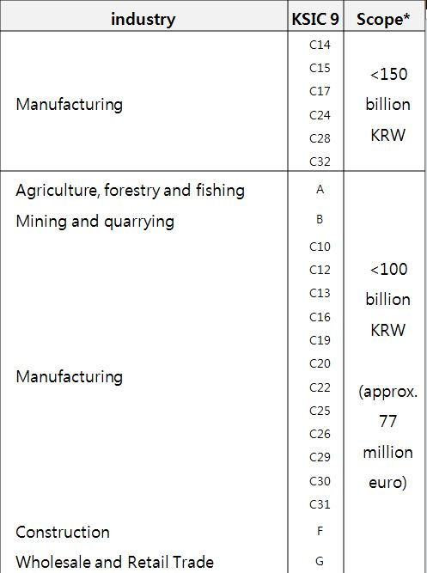
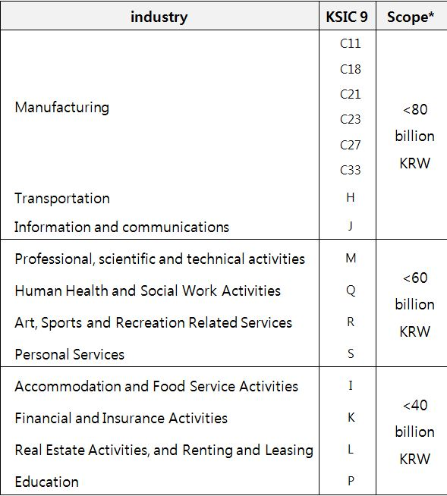
Identifying Korean SMEs
Framework act on Small and Medium Enterprises (§2.Definition)
* 3-year average sales

Slide 13
Main Findings: SMEs Statistics Using SBR
Number of enterprises (provisional)
(unit: each , 2015)
Category |  | Overall | Small |  |  | Medium | Total | Large
 |  |  | Micro | Others | Total |  | SMEs
(Share, %) | Census on Establishment | 3,604,773 | 3,084,376 | 415,955 | 3,500,331 | 100,551 | 3,600,882 | 3,891
 |  | (100.0) | (85.6) | (11.5) | (97.1) | (2.8) | (99.9) | (0.1)
 | SBR | 6,632,988.0 | 6,252,041.0 | 288,534.0 | 6,540,575.0 | 85,529.0 | 6,626,104.0 | 6,884.0
 | (Enterprise) | (100.0) | (94.3) | (4.3) | (98.6) | (1.3) | (99.9) | (0.1)

Slide 14
Main Findings: SMEs Statistics Using SBR
Number of employees (provisional)
(unit: person , 2015)
Category |  | Overall | Small |  |  | Medium | Total | Large
 |  |  | Micro | Others | Total |  | SMEs
(Share, %) | Establishment | 16,774,948 | 6,065,560 | 5,042,200 | 11,107,760 | 4,019,287 | 15,127,047 | 1,647,901
 |  | (100.0) | (36.2) | (30.0) | (66.2) | (24.0) | (90.2) | (9.8)
 | SBR | 20,458,260 | 8,186,630 | 4,513,212 | 12,699,842 | 3,917,041 | 16,616,883 | 3,841,377
 | (Enterprise) | (100.0) | (40.0) | (22.0) | (62.1) | (19.1) | (81.2) | (18.7)

Slide 15
THANK YOU!
Economic Statistics Planning Division
Director, Kim Bokyoung
Tel: +82. 42. 481. 2181
Email: bokyoung2@korea.kr

