Slide 2
Organisation of Chain Management
What, Why, How?
Irene Salemink
26th Meeting of the Wiesbadengroup on BR – Neuchâtel 24-27 September 2018
Notes:
Warning in Advance, todays keynote will NOT be about Business Registers or Admin Data nor new Data Sources.
Also Topics like Profiling, Globalisation, Quality and Coverage of Statistical Business Registers you will not see back in the slides.
However, if you read between the lines you will see that the theme of today relates to all of them and binds everything together → namely → <3>

Slide 3

How we work together
Notes:
This Key note is about → “How we work together” → as statisticians, as BR specialists within NSI’s, internationally as a community.
The outline of the presentation will be roughly as follows <4>

Slide 4
Topics
A bit of Theory on Alliances
Build a CHAIN of Economic Statistics
How to manage Alliances
Chain Management in SN Business Statistics
The Result
A Network of collaborating NSI’s
Chain Management?
Notes:
Starting with a bit of background theory
Translating it to the statistical domain followed by the experience at Statistics Netherlands and a peep through to applicability in international cooperation.

Slide 5
A bit of Theory on Alliances
Notes:
Are Alliances in public-private partnerships a recent phenomena of our time? Not really, at least collaborations between enterprises are as old as the existence of such enterprises…for example the early credit institutions or trade associations like the Dutch guilds.
There always have been strategic alliances but the last couple of decades the focus and reasons for strategic alliances has evolved quickly
In the 1970s, the focus of strategic alliances was the performance of the product. Partners wanted to attain (raw) materials at the best quality and the lowest price possible or the best technology and improved market penetration
In the 1980s, the number of strategic alliances increased dramatically and the involved strategic alliances aimed at building economies of scale and scope trying to consolidate their positions in their respective sectors. Think of photocopiers by Canon sold under the brand of Kodak, or the partnership of Toshiba and Motorola whose joining of resources and technology lead to great success with microprocessors.
In the 1990s, geographical borders between markets collapsed and new markets could be entered. Due to higher requirements for the companies there was a need for constant innovation to stay competitive. The focus of strategic alliances moved to the development of competencies.
It is this domain of competencies and knowledge that is also typical for the innovative oriented public-private partnerships.
Now what are Alliances and what makes them special? <6>

Slide 6

What is an Alliance ?
A partnership between organizations that, further to their own objectives, pursue jointly selected or politically imposed objectives.
Alliance partners are independent.
And also depend on each other
when it comes to achieving their
joint objectives.
Notes:
An alliance is a partnership between organizations that pursue one or more, jointly objectives.
These alliance partners are independent, although they also depend on each other when it comes to achieving their joint objectives.
As we will see later, An NSI can be seen as an Alliance as well, with the different producers of related statistics as alliance partners
alliance partners are confronted with a number of some typical features <7>

Slide 7

Alliance Features
Diverging interests
Duration
Dependency
Dynamic Environment
No Boss
Imbalance
Notes:
Diverging interests
Firstly, alliances are set up between ‘independent’ organizations so they must bridge the structures,
cultures and processes of different organizations. Which is of course not an easy endeavor and may lead to ineffective outcomes when mixed in an alliance.
Dependency
Secondly, there is the mutual dependence in alliances, whereby the parties rely on each other and none of the partners can achieve the desired objective by itself.
No overarching authority
Thirdly, in every alliance there are at least two independent organizations involved. However there is no Boss, no overarching authority.
Imbalance
Fourth, there is always a difference in extent and variety of input from alliance partners which puts the balance within
the collaboration under pressure. The more prominent partner must explicitly factor in the interests of the smaller partner.
Dynamic environment
Fifth, alliances do operate in dynamic environments. one. Political changes in governance, new regulations, technology,
social wishes have an impact on the alliance. Specifically for public-private alliances there may occur friction between political and
economic objectives.
{{It is unfeasible to exhaustively capture all matters that may arise in a collaboration agreement beforehand.
Instead there is a so-called ‘contractual space’ that needs to be managed.}}
Duration
Finally, alliances generally have a lasting nature, usually being contracted over a long-term period. {{However this
does not make them permanent by definition because when a certain problem is solved, the alliance can be
dissolved. }}
These features also demand separate alliance management models <8> because <<8>>

Slide 8

The challenge….
Notes:
Because when two or more independent partners form an Alliance, there needs to be horizontal cooperation at certain levels like for example management, organization, information and technology.
However this horizontal linkage and collaboration leads to the most important tension in Alliances namely the clash that arises between the interests of the individual organization and those of the alliance.
Besides Alliances there are of course many more types of collaboration <9>

Slide 9
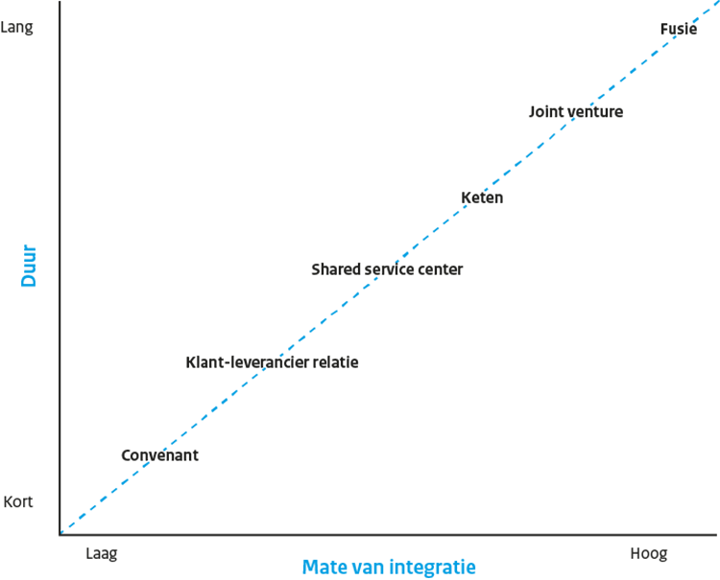

Organisational Forms
Merger
Long
Joint Venture
Chain / Alliance
Duration
Shared service centre
Customer-Supplier relation
Covenant
Short
Low
Degree of Integration
High
Notes:
In fact, alliances prove complex and not without risks, and are therefore not always the most appropriate form of collaboration.
In this figure, organizational forms are classified by integration intensity between the organizations involved and based on the
intended duration of the collaboration (long-term vs. short-term).
Alliances are somewhere at an equilibrium of high but not full integration and long term duration but not permanent.
Adopting alliances depends on a number of specific conditions. <10>

Slide 10
Alliance collaboration only if…
Intensive collaboration
Collaboration on a sub-area and not all areas
Activities cannot be separated from the organisations, collaboration directly between core processes of partners
Collaboration is long term and not once-off
Notes:
Alliance cooperation is only superior and preferable if the following conditions are met:
• There is intensive collaboration (thus more than a customer-supplier relationship or covenant);
• The collaboration takes place on a sub-area and not in all areas of the organization involved
(a merger would be required to that end);
• Collaboration activities cannot be separated from the organizations: The collaboration takes place
directly between the core processes of the partners (otherwise, a joint venture or SSC would be
appropriate);
• The collaboration is long-term and not once-off (the covenant and the customer-supplier relationship
are therefore not an alternative).
Specifically in the public sector, joint ventures and mergers are unlikely to occur. Because of the
the departmental division and separate (political) responsibilities.
Alliances are in fact the most far-reaching form of collaboration in which the (ministerial) autonomy
of the partners is retained. And due to the intensity and duration of the relationship, alliance collaboration
in the public sector is often the only option.
An example in the Netherlands is the Alliance for data on tax and wages <11>

Slide 11
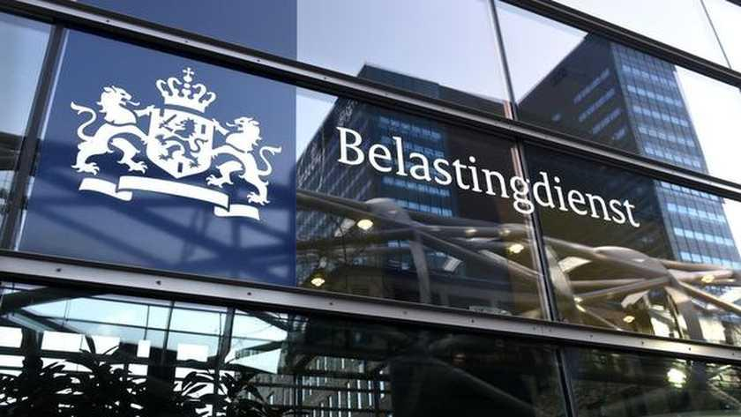


Dutch Alliance for data and tax on wages
Employers/
institutions
Contract
users
Covenant
Notes:
The heart of the alliance comprises of alliance collaboration between the IRS (Internal Revenue Service i.e. the Dutch Tax and Customs Administration), SSA (Social Security Authority), and Statistics Netherlands.
There are however additional collaboration forms. At the front side of the alliance, collaboration with (large) employers and institutions is supported by covenants.
At the backside of the alliance, the relationships with users of information are supported by supply contracts, as is customary in customer - supplier relationships.
Why would Public organizations participate in public or public-private alliances ?? <<12>>

Slide 12





Rationale behind Alliances
Notes:
Well for a variety of reasons:
Customer service delivery is an important element. The customer wants one-stop-shopping to request a single service,
Specifically when it concerns public organisations
Reducing administrative burdens is high on the political agenda. By forming Alliances the administrative burden
for employers for example can be reduced by requesting data only once and using it multiple times throughout all
public organizations represented in an alliance.
Reducing the number of errors in the administrative process is also an important driver for alliance
formation. When organizations use the same data source the occurrence of an error in the various administrative processes is notably reduced.
Better collaboration in the alliance reduces its operational and implementation costs and therefor increase efficiency.
In the Dutch criminal justice alliance, for example, the introduction of electronic files could reduce the shuffling back and forth
of paper files.
And finally there are increasingly innovative reasons for starting alliances. Dependency between organizations offers uncovered
opportunities through the bundling of knowledge and expertise. Successful alliance collaboration stimulates creativity and contributes to social innovation and effective public administration.
So there are many reasons to start an Alliance but how do we make this work then? <<13>>

Slide 13
How to manage Alliances?
Notes:
The question is how to manage An Alliance??? <<14>>

Slide 14
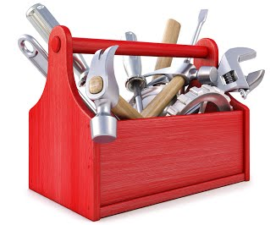
Managing an Alliance; dynamics and complexity
Partners undergo internal changes
Friction between horizontal and vertical management
Environment PRODUCES new questions or regulations
Different development stages (maturity)
          A mix of management elements needed!
Notes:
From what we have heard it seems evident that alliances present a certain level of dynamics and complexity,
Alliance partners may undergo internal changes
The previous mentioned frictions between horizontal and vertical management are also a continuous source of change.
Also the environment may produce new questions or regulations, which can influence the alliance.
And finally, alliances can go through different development stages.
So how does one manage such an Alliance??
Well, this dynamic can only be dealt with when ALL management forms that are present in managers’ toolboxes
are used together. <<15>>
Some Key elements of this toolbox are <<15>>

Slide 15


Key elements
Mindset focused on alliance collaboration
Space for alliance partners to play within game rules;
Trust in collaboration;
Communicate in an open dialogue
Management based on an alliance structure
Transparency with regard to tasks, power
and responsibilities
Knowledge sharing
Inspiring, meaningful objective for the alliance.
Notes:
From these key elements its clear that not only Content and Procedures count but that Relational and Cultural element are equally (maybe even more) important in effectively managing an Alliance!!
It is also clear that the usual frameworks and management instruments, based on one-person leadership and hierarchy, are inadequate to manage alliances properly due to the absence of “one boss” .
Respect for the equality of alliance partners and the ‘non-intervention principle’ are actually the success factors in alliance collaboration.
In the theory behind mastering Alliances a number of areas are depicted/recognized as important and that demand active management. <<16>>

Slide 16
Management dimensions
Notes:
In fact collaboration suffers when one or more of these dimensions are not properly managed.
This is because every management dimension features a possible friction in which a workable balance must be sought.
For example there should always be a ‘will’ to develop alliance collaboration within the cultural dimension.
Within the relational dimension it is the nature of the relationship that determines whether alliance partners
collaborate ‘together’ or work independent (‘solo’). This requires management and maintenance of the relationship
development process.
As for the procedural dimension, the question is whether everything can and should be brought to order, or whether
a certain degree of freedom chance for chaos) is desired?
Finally, within the content-dimension, partners come across many ambiguous and unclear items on which they may disagree,
such as objectives, definitions, etc. This requires management of the knowledge sharing process.
Thus alliance management essentially focuses on four dimensions: Growing a mindset (culture),
building trust (relationship), making agreements (procedure) and sharing knowledge (content). <<17>>

Slide 17
8 pillars of Alliance management
Notes:
The Alliance management model is completed by identifying two so called focal points per dimension {{eight
alliance management pillars).
Denial or neglect of one or more of these eight pillars weakens the foundations of an alliance
and, sooner or later, probably sooner, leads to misunderstanding, distrust and inevitably to failure.
Thus forming Alliances is something not to be taken too light hearted!!
Where Alliances are something typical for public-private partnerships we can learn a lot about them and
Implement the way of working and thinking in our daily statistical practice! <<18>>

Slide 18
Chain management?
Notes:
At Statistics Netherlands we call it CHAIN MANAGEMENT.
Chain management can be seen as a form of Alliance management where the Alliance is the cooperation within an NSI, and the cooperating partners are the producers of individual economic statistics that are however related in some way.
Now I can hear you think WHY get yourself into something risky with lots of difficulties and complexities when you are in one organisation with similar interests and clearly one boss. ??
That is what the second half of this presentation will be about <<19>>

Slide 19
Chain Management
Coordination of the VARIOUS statistical processes by:
Processing and designing statistical products from the perspective of the whole CHAIN
Chain designed as a set of links between processes,
a link is a so called steady state defined in the BA
Set of management and operating activities aiming for improving cooperation of all actors in the chain
Notes:
In this presentation Chain management is confined to the coordination of all the various statistical processes that
are included in the chain of Business economic statistics.
This coordination starts with processing and designing the statistical products i.e statistical outcomes from the
perspective of the whole chain of business economic statistics.
That is also why working under architecture is key.
Equally important is the attention for management and operating activities that all have one main focus and that is improving
the cooperation of all actors in the chain. <<19>>
{{The chain in general is set up as a set of links between processes,
in which each link is a so called steady state. These steady states are all defined in the Business architecture of SN.
In a moment I will show this BA and steady.}}

Slide 20
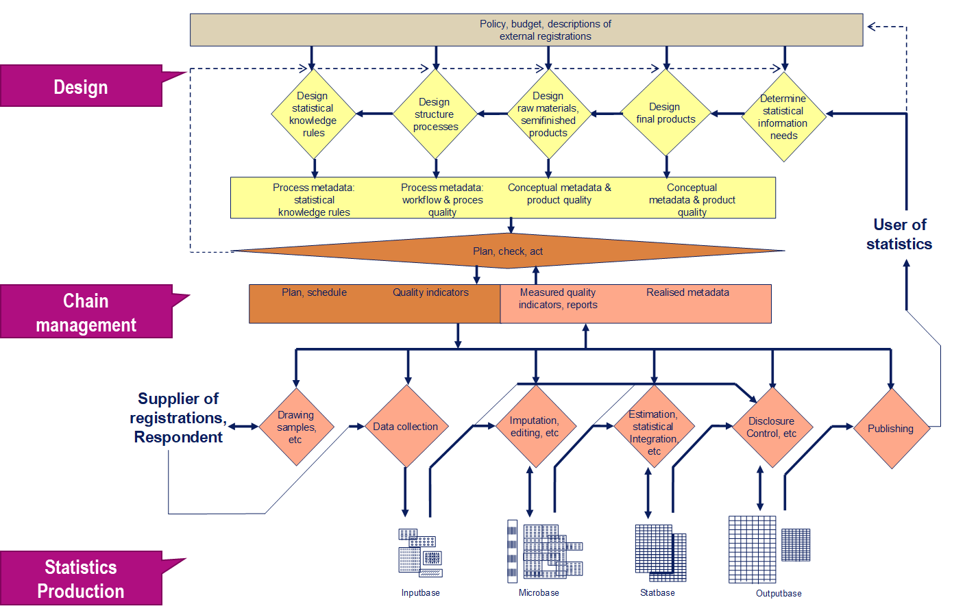
Notes:
As mentioned already, a necessary condition to implement chain management is also to adopt working under architecture
because essentially the Business Architecture describes the statistical processes already as a CHAIN.
From that it is far more easier to design statistical CHAINS that are bound together like the Chain of business economic statistics.
In the Dutch Business Architecture that we see here (GSPBM) we define three layers;
1. Design
2. Chain management (concerning PLANNING, MONITORING and REPAIR)
3. and the actual Statistics production from data collection to publishing.
In this production layer each process step ads value by eliminating uncertainties about the data, if necessarily, data are corrected and subsequently after every next step the data has attained a specific higher quality level and reaches the next steady state.
These steady states are a Key element in the BA and as we will see later also in CHAIN Management.
We see this sequence of process steps and steady sates in all the single production processes of statistics but also when we “connect them” like the process of the STS production to that of the production of Structural Business Statistics.
Within one process you can work within one loop but going from one process to another two loops are connected like two beads in a chain.
The Chain management layer in the Dutch BA is defined as follows <<21>>
Intermezzo
Although working under BA may be demanding. For instance because reorganization of statistical processes is time consuming and implies a temporarily break in time series as well as an increase of the development cost because new applications and software are needed. However working under BA outweighs these disadvantages because of the
- Centralization of designing activities and documentation of statistical processes
Control of statistical processes by joining similar statistical activities into one (data)base
Control of statistical processes and improvement of coherence in processes and activities by working with “steady states” and “steady stages”.
Unambiguous use of statistical concepts, the most important here to mention of course the use of the statistical units in the SBR
The processing and maintenance costs will reduce as well as the administrative burden
The Business Architecture model that we see here
Describes statistical process as a value added chain
Each process step adds value by eliminating uncertainties about the data
Each step checks for specific possible errors and corrects for them – if necessary
After each step the data have attained a specific (higher) level of quality
This increases the possibilities to re-use data in other processes

Slide 21
Chain Management
A way of working together in a NON-HIERARCHICAL way
The ART of working together aiming for tuning activities
Agreements on management and operating activities with one goal
Continuously improving COOPERATION of all actors in the chain
Notes:
Chain Managements is a way of working together in a non hierarchical way. It’s the ART of working together,
Aiming for tuning activities.
Agreements on management and operating activities exist with one goal and one goal only and that is to continuously improve the cooperation of all actors in the chain.
This sounds a lot like we have heard before when describing Alliance management.
Before I will go into HOW we introduced Chain management at SN first the WHY needs to be answered <<22>> <<23>>

Slide 22
Chain Management in SN Business Statistics
Notes:
<<23>>

Slide 23
Economic Statistics; building blocks
Surveys
STS
Surveys
SBS
Inputs e.g.
Int. trade
Int.trade
Oth.sources
Other sources
Processes
STS
QNA
SBS
NA
Output e.g.
Notes:
Introducing chain management at Statistics Netherlands did not come out of the blue of course.
We had some serious drivers to change our day to day practice. One of these drivers had to do with a major quality issue.
Here we see schematically the production of two key business economic statistics, the Short Term Statistics on quarterly turnover
and the Structural Business Statistics as well as the National Accounts on a quarterly and yearly basis.
On the input site we have Surveys for both STS and SBS, and additional sources for NA like the Consumer Expenditure Survey
The STS forms input for the quarterely NA and the SBS for the annual economic growth.
<<24>>

Slide 24
Economic Statistics; outputs
Surveys
STS
Surveys
SBS
Inputs e.g.
Int. trade
Int.trade
Oth.sources
Other sources
Processes
STS
QNA
SBS
NA
Output e.g.
Quarterly turnover
Annual turnover
Quarterly ec.growth
Annual ec.growth
Annual ec.growth
Notes:
Here we see the outputs:
The quarterly turnover for STS, the Demand & Supply Tables (QNA / NA) and the annual turnover.
Since 4 quarters make up a year it should be expected that we see this rationale back in our outcomes
And that the Quarterly economic growth would be an adequate estimate for the Annual growth. As would be the quartely turnover for the annual turnover<<25>>

Slide 25
Economic Statistics; diverging outputs
Surveys
STS
Surveys
SBS
Inputs e.g.
Int. trade
Int.trade
Oth.sources
Other sources
Processes
STS
QNA
SBS
NA
Quarterly turnover
x 4 = ?
Annual turnover
Output e.g.
Quarterly ec.growth
Annual ec.growth
= ?
Annual ec.growth
Notes:
This however was NOT the case!!
The quarterly figures were no good estimations for the Annual turnover NOR the economic growth…...in fact the
figures showed a bias that in fact grew bigger and deviated more and more further in time.
Thus one of the important drivers for change was definitely quality driven <<26>>

Slide 26
Why Chain management; drivers for change
Quality improvement
  smaller revisions, less rework/repair
  bigger consistency (between or within statistics)
  consistent treatment of large enterprises
Increased predictability and responsiveness
Higher (process) efficiency / cost reduction
More and coordinated use of register data
Easier maintenance of software, procedures, workflows
Notes:
With amongst others a demand for smaller and less revisions, rework and repair.
At the same time there were large budget cuts, 20% over a period of 4 years, followed by efficiency cuts of 1-2% on a yearly basis till 2020.
Leaving it no surprise that equally important drivers were process efficiency, cost reduction and more use of register data.
So the question we had to ask ourselves at SN was how we were going to deal with an increased complexity, the pressure to combine all various data sources as efficiently and less burdensome as possible and still release high quality frames and statistics in time??
Well we definitely had to take a different look at our way of working <<27>>

Slide 27

Take a different look
Notes:
Which lead to the initiative to introduce CHAIN management and build a real CHAIN of economic statistics <<28>>

Slide 28
Build a CHAIN of Economic Statistics
Notes:
Before the “BUILDING” could start first the “DESIGNING” took place starting by designing some Organisational principles
that were followed to Organise the new DIVISION of business economic statistics and National Accounts <<29>>.

Slide 29
Organisational principles
Create a “highway” within one organisational division
Centralize business statistics departments positioned close to NA
Create a new department that focuses on consistency for the large companies in close proximity to the SBR
Position the SBR within the chain (backbone of the statistics) and expand the role of the BR (coupling admin sources)
Appoint a CHAIN manager (not a process owner!)
Notes:
In redesigning the Division of Business Economic statistics (and NA) we created a
so called highway where all the business economic statistics were positioned in one organisational Unit together with NA and the SBR department.
The departments producing SBS and STS where all moved to The Hague and positioned clos to NA
In Heerlen a new department was created that is responsible for the Complex and Large Enterprises…from Profiling to exclusively producing economic statistics on their data.
The Statistical Business Register was also put in the same organisational division with a strengthened role as THE BACKBONE for all
Business economic statistics.
And a chain Manager was appointed, not being manager of one of the departments nor a process owner,
in fact the chain manger act as an independent orchestrator of all the processes involved.
Which are <<30>>

Slide 30
Processes involved in our Chain
Business register
Consistency largest enterprises
Direct estimates turnover (STS)
Production statistics (SBS)
Integration: Quarterly National Accounts
Integration: National Accounts
Notes:
These are the involve processes.
These processes where acknowledged to be all connected and or dependent on each other as we see when modelling the
Process flows <<31>>

Slide 31
Flows
Business register
Consistency largest enterprises
Direct estimates turnover
Production statistics
Integration: National Acc.
Integration: Quarterly NA
Notes:
The Statistical Business Register (SBR) is a crucial part of this FLOW chart (indicated by the star) and offers a coordinated population
to ALL other processes. In fact the SBR is positioned as THE backbone for ALL economic statistics and plays a central role in their production.
As we see in this picture, since all processes are linked together improving the quality of one process and it’s outcome will affect the other processes and it’s outcomes as well.
It will also be clear that improving the quality at the beginning of the these linked processes will be more rewarding and beneficial than improving it at the end. Also when correcting a statistical outcome without correcting the source of the error the error may re appear over and over again.
When a correction is or cannot be used by other processes then they also will not benefit from the quality improvement.
Since the SBR stands at the beginning/basis of all the processes to follow it is also likely to be the first place to
correct errors and to repair them in a coordinated way.
Also the adjustments of statistical estimates are preferably coordinated amongst all processes as well as the activities dealing with the prevention of inconsistencies.
For example frame errors, they can be detected at various places in the statistical production process as well as at the SBR, it is however the statistician of the affected economic variable who needs to approve the correction. For coordinated variables like NACE code and size class the corrections are always corrected in the SBR.
Even better than correcting is preventing the occurrence of inconsistencies. This is done for around 320 of the largest and most complex enterprise groups who together comprise almost 75 % of the total turnover. These enterprises are dealt with in a separate process where the relations with the EG are maintained, the structures are profiled in the SBR and where also micro data processing takes place with the aim to deliver consistent micro data for direct use in statistics including national Accounts.
So in our new Highway of Business Economic Statistics we introduced two processes specifically for improving Coordination and Consistency.
However for maximum improvement of coordination and consistency we reckoned that this network or chain of processes
Needs to be operated and managed as if it is ONE INTEGRATED SYSTEM …thereby recognizing the individual needs and benefits of the comprising processes.
Does this sound familiar??? Yes….Et voila, chain management….as a kind of Alliance management….was born.
This meant in the first place that ALL partners in the business economics domain had to adopt the same and binding conditions <<32>>

Slide 32
Conditions
Maintenance procedures for changes in statistical units
Redesign of basic processes in one integrated approach
Chain management procedures
Notes:
The conditions are:
Adopting Maintenance procedures for changes in SU
A complete redesign of the basic processes in one integrated approach
And adopting and implementing Chain Management procedures
Adopting these conditions was of course not enough to establish chain management and introduce an integrated approach
Therefore we really had to change various elements in our way of working <<33>>

Slide 33
Change!!
Better use of SBR and Administrative sources
More methodological coherence
Streamlining processes
Notes:
The Changes we established concerned 3 main areas
1. Better use of the SBR AND administrative sources
2. More METHODOLOGIACL coherence
3. STREAMLINING processes
Concerning the better use of the SBR <<34>>

Slide 34
1. Better use SBR and administrative sources
Introduction new version of statistical unit for better linking with various sources
Use of quarterly VAT-declarations for SME for turnover (700.000 units), combined with surveys for the 1900 largest enterprises (some 8500 stat.units)
Monthly estimates based on a model to extrapolate quarterly data using monthly survey data on turnover for largest enterprises
Notes:
An extended version of the Enterprise, namely the ENTERPRISE group made it possible to better link various administrative sources like the VAT declarations.
Also the methodology was adapted in which aligning monthly turnovers with quarterly estimates is an important feature <<35>>

Slide 35
2. More methodological coherence
Special organisational unit for consistent data on the largest 350 enterprises
Quarterly turnover data based on practically complete coverage
Used for growth estimates STS, QNA and first annual estimates NA
Used for level estimates SBS and final annual growth estimates NA
Monthly turnover aligned with quarterly estimates
Notes:
This was established by using the quarterly turnover for the growth estimates of the Short Term Statistics
and for the estimates on QNA and the first annual estimates of National Accounts
In addition the quarterly turnover data were also used for the LEVEL estimates the SBS as well as for the final
annual growth estimates of NA.
These principles put a kind of constraint on the statistical system thereby ensuring methodological coherence.
The third example of CHANGE had to do with streamlining the processes <<36>>
Intermezzo
Because of the demand for lower admin burden we first had to redesign the production processes in order to achieve a better linkage with administrative sources. Therefore also the statistical Business register had to be placed in a central backbone role AND it had to be based on a new version of the statistical unit. In this way the SBR forms the backbone and zips the information from administrative to the statistical units.
Secondly the use of survey data is only reserved for the largest enterprises, for the small and medium enterprises the VAT turnover is used.
Thirdly the STS turnover in turn is used in the compilation of SBS statistics assuring methodological coherence between them.
In addition methodological coherence was used by processing consistent economic date on the 350 largest enterprises by making the survey data from SBS and STS consistent with other statistics (like international trade, Prodcom, investment, employment and wages etc.).

Slide 36
3. Streamlining processes
Use of business architecture with separate process steps and well-defined intermediate data sets
More extensive use of automatic editing routines
Interactive editing only after top-down analysis
Better use of reference data from other processes
Top-down analysis and better tools for QNA and NA
Better communication between processes / systems on analysis and editing decisions
Notes:
Of which we see here some examples.
ALL described changes and conditions where worked out in Procedures. <<37>>

Slide 37
CHAIN Procedures
Detailed and binding agreements on deliveries in the chain
Use of statistical business register for all statistics involved
Co-ordinated approach to changes in units, correction of errors et cetera
Detailed procedures for handling changes, incidents et cetera
Chain manager and Chain management group in the lead
Notes:
There exist detailed and binding agreements on deliveries of the outcomes of the concerned processes. These procedures
are like Service level agreements. Very crucial is the obligatory use of the Business Register and it’s statistical units.
Changes are always corrected in a coordinated approach because they may affect other statistics.
And there exist procedures for them for which we have a handbook that is yearly evaluated and updated if necessary.
WHAT did all the EFFORT LEAD to then in the END you may ask?? <<38>>
Intermezzo
Tuning SBR maintenance with statistical processes
Derive maintenance subgroups
Consult statisticians before final frame is derived
Store changes which affect the structure or the characteristics of a SU (events)
Check quality of administrative sources in advance (reporting facilities)
Select ‘frozen units frame’ from the SBR Live Environment
Use ‘application dates’ instead of ‘event dates’ to determine the reference period for the SUs in the frozen frame for all business statistics involved

Slide 38
The Result
Notes:
<<39>>

Slide 39
Coherent Statistics
Short-term turn-over statistics
Σ Quarterly turnover ≈ annual turnover
Quarterly National Accounts
Σ Quarterly GDP-growth ≈ annual GDP-growth
Production statistics
Quarterly VAT-turnover data small/medium enterprises
Survey turnover data large enterprises
Survey data largest enterprises made consistent with other statistics
National Accounts
Notes:
WELL it did lead tot COHERENT and Qualitatively improved Business Economics Statistics of both the CHAIN as a WHOLE as well as of its individual building BLOCKS (which are the individual statistical processes).
Which can also be presented more like a real chain…<<40>>

Slide 40
Economic Statistics as a CHAIN
Surveys
Dir.est
Surveys
PS
Inputs e.g.
VAT
Int. trade
Dir.est
Int.trade
Large ent.
Oth.sources
Large ent.
Other sources
Processes
Dir.est
QNA
PS
NA
x 4 ≈ !
Output e.g.
Quarterly turnover
Annual turnover
Quarterly ec.growth
Annual ec.growth
≈ !
Annual ec.growth
Notes:
Input = Input-processes; Throughput = Throughput-processes; Output = Output-processes
DS = Demand & Supply Tables (QNA / NA)
DT = Direct Estimation of Totals => STS
PS = Production Statistics => SBS
OthSc = Other Sources = Consumer Expenditure Survey (budget onderzoek)

Slide 41
Benefits of the integrated Chain Approach
Structural underestimation of quarterly GDP was solved
In general less and smaller revisions
Consistency between statistics & more methodological coherence
Better use of administrative sources & reduction in administrative burden
Redundancy in data processing is prevented
Issues solved in joint consideration and at most cost efficient place in the chain
Notes:
By introducing CHAIN management and EVERYTHING that comes with it we were able to solve the structural underestimation of the GDP. In general we now suffer from less and also smaller revisions. Also there is more methodological coherence and consistency between statistics. Because of the increased and a better use of administrative sources in general a reduction in administrative burden was realized.
Also from the financial point of view it is beneficial since no over processing is taking place any more. And before solving an issue it is first considered, with all members of the chain, where in the chain it is the most cost efficient to repair.
So we have redesigned our business economics and NA to an integrated chain model, supported by a BusinessArchitecture.
We have met de necessary conditions, like a central role of the BR with statistical units facilitating maximal use of administrative sources
There is agreement on maintenance procedures for changes in statistical units and many other chain management procedures are in place.
Are we there yet than, have we finished?
Not really, like in any other relation, our CHAIN needs continues maintenance and updating, <<42>>

Slide 42
NA
Large enterprises
Production statistics
BusinessRegister
QNA
Data exchange points
Turnover
Data collection
Notes:
….Maintenance and updating of the individual processes as well as the Chain as a whole, since it is complex and dynamic!!
Like any other Alliance cooperation
Designing CHAINS and introducing CHAIN management is not reserved for statistical processes within NSI’s.
All ingredients I mentioned in this presentation are also present in for example networks of collaborating NSI’s, but than at a larger and international scale <<44>>

Slide 43
A Network of collaborating NSI’s…
Notes:
Like for example the ESBR’s <<44>>

Slide 44
European System of Interoperable BR’s
Increased CONSISTENCY between and within ESS Business Economic statistics at national and EU level
Increased QUALITY of Business Economic statistics
SBR’s and EGR as backbone for business statistics
Interoperability between SBR’s
Consistency in the treatment of Large Enterprise Groups
Establishment of EGR
Notes:
The European System of Interoperable Business Registers.
Given these joined goals it seems that the Introduction of CHAIN management may contribute to a successful and sustainable
Collaborative network.
The first DESIGN principles are already there and they may sound familiar in the light of this presentation <<45>>

Slide 45

ESBRs Design Principles
SBR’s provide a shared (coordinated) view on business populations (frame population)
ESS partners will (and must) use this shared view in the production of business statistics
Notes:
Other example we might even find at a global level <<46>

Slide 46
Other Examples
Notes:
<<47>>

Slide 47
Notes:
Like the UN initiative on USING BIG DATA in official statistics where TRUSTED DATA collaboratives are essential
Which also holds for the development of a global platform for the discovery, access and use of data, statistical methodology, software application and production of statistics and indicators (like SDG’s) <<48>>

Slide 48
Notes:
So there are many more areas where we might want to consider Chain management or Alliance management in order to run, maintain and manage complex forms of collaboration between us
This brings me then to the conclusions <<49>>

Slide 49
Conclusions
Collaboration is about mastering the ART of working together
Where Chain management offers a valuable framework and management instruments
Which should enable us to run complex collaborative networks in a non hierarchical way
Notes:
Collaboration is about mastering the ART of working together
Where Chain management offers a valuable framework and management instruments
Which enables us to run complex collaborative networks in a non hierarchical way

Slide 50
Mastering Alliances
https://www.noraonline.nl/images/noraonline/0/01/Mastering_Alliances.pdf
Notes:
For those who want to read more on this topic, the part of Alliances is from the Dutch Government Reference Architecture
Explanation:
The ‘Allegory for good and bad governance’ is a series of frescoes that was painted around 1338 by Ambrogio
Lorenzetti. The frescoes can be found in the council hall of the Palazzio Pubblico in Siena (Italy). One of the
six scenes is titled the ‘Allegory of good governance’.
In this fresco, which symbolises the governance of the State of Siena, one can see at the bottom the citizens
of Siena who are bound together by a braided cord. On the one hand, the cord runs to the monarch, who
represents ‘the Board’ of the city, and who is assisted by six female councellors, among which the four
cardinal virtues: Fortitudo (Courage), Prudentia (Prudence), Temperantia (Temperance) and Justitia
(Justice).
On the other hand, the cord runs through Concordia (Harmony) to the scales of the judicial authority. The
‘Board’ is thus linked to the judicial authority via the citizens and Harmony. This painting has the purpose
of a mirror for monarchs in the Middle Ages to remind them of the virtues they must practice to make
courageous, thoughtful, balanced and fair decisions, thereby, ensuring good governance. A mirror which
can still be interesting for board members in our time.

Slide 52


Questions?
Irene Salemink
Director Production Services
CBS / Statistics Netherlands

