Slide 1
Efforts to Enhance the Quality of the Economic Census in Japan
- the Economic Census for Business Activity -
Masatsugu KITAHARA
Masao TAKAHASHI
Statistics Production Support Division, Statistics Bureau,
Ministry of Internal Affairs and Communications
Government of Japan

Slide 2
Contents
Introduction
Economic Census
Efforts to Enhance the Quality of the EC-BA
Results of the Efforts
For the Next Survey

Slide 3
Introduction
Various statistical surveys
Census of Manufactures
Census of Commerce
Economic Census
Business Frame
Business Activity
Administrative data sources
Commercial and Corporate Registration
Information of Labor Insurance etc.
Financial Statements Statistics of Corporations by Industry etc.
Establishment
Frame
Database
(Business Register)

Slide 4
Contents
Introduction
Economic Census
Efforts to Enhance the Quality of the EC-BA
Results of the Efforts
For the Next Survey

Slide 5
Economic Census
Economic Census
Business Frame
(EC-BF)
Business Activity
(EC-BA)
“Address,” “Name,”
“Number of employees,”
etc.
To clarify the basic structure of
establishments and enterprises.
“Sales,”
“Added Values,”
“Expenses,”
etc.
To clarify the condition of economic activity of establishments and enterprises.
These are complete surveys of
a five-year cycle.

Slide 6
Outside the Survey Objects
Establishments of individual proprietorships that fall under “Agriculture, Forestry and Fisheries”
Establishments that fall under “Domestic services” in “Living-related and Personal services and Amusement services”
Establishments that fall under “Foreign governments and International agencies in Japan” in “Services, n.e.c.”

Slide 7
The Utilization of the Economic Census
Utilization based on various Acts and Regulations, or for various Policy Planning
Utilization for System of National Accounts, Input-Output Table and Reports, etc.
Utilization by Enterprises, Research Institution, etc.
Enterprises : Use for grasping market trends by industry, estimating market scale, etc.
Research Institutions : Use for analyzing changes in industry and enterprise structure.
Business Register
Local Tax Act
Small and Medium Enterprises Policy
Regional Revitalization Policy
Demographic Policy
Disaster Prevention Policy
System of National Accounts : Use the number of establishments of “Manufacturing” and “Wholesale and retail trade” due to estimating capital investment of proprietorships.
Input-Output Table : Use it as basic data of Input-Output Table showing goods and services produced by a certain industry.
Reports, etc. written by government agencies : Use for grasping market trends of the small and medium enterprises by industry and grasping trends of content markets, etc.

Slide 8
Contents
Introduction
Economic Census
Efforts to Enhance the Quality of the EC-BA
Results of the Efforts
For the Next Survey

Slide 9
Efforts on the Survey Method
Coverage of Survey
Companies that were difficult to investigate were changed to the direct survey by MIC* and METI*.
Online Survey
Online response was possible at all establishments.
Preprint
Items preprinted were newly added.
Type of Questionn-aire
Questionnaires were integrated and newly added.
The 2016 EC-BA
*MIC shows Ministry of Internal Affairs and Communications
*METI shows Ministry of Economy, Trade and Industry

Slide 10
Efforts on the Aggregate Procedure
Questionnaires not submitted
Imputation by the list updated by enumerators
Unanswered items
Cold-deck imputation
Ratio imputation
Confirmation
EDINET*
Corporate Website
Calling
*EDINET is the “administrative data source”
related to enterprises.
Accuracy Improvement
as Data

Slide 11
Treatment of Consumption Tax
When seeing the results of the 2012 EC-BA, it needs to be paid attention to the sales which include both with and without consumption tax.
In the 2016 EC-BA, the sales without consumption tax were changed to the sales with it.
Feb. 1, 2012
EC-BA
Aggregate results mixing with and without consumption tax
Apr. 1, 2014
Consumption tax was raised from 5% to 8%
Jun. 1, 2016
EC-BA
Aggregate results with consumption tax

Slide 12
Contents
Introduction
Economic Census
Efforts to Enhance the Quality of the EC-BA
Results of the Efforts
For the Next Survey

Slide 13
Response Rate
 | 2012 EC-BA | 2016 EC-BA | Difference
Survey by enumerators | 87.7% | 89.0% | 1.3%pt
Survey by direct mailing (of direct mailing) by MIC or METI | 92.0% 92.6% | 92.1% 96.3% | 0.1%pt 3.7%pt
The rise in the response rate may be attributed to changing in the survey date.
2012 EC-BA
Feb. 1, 2012
Due date of Final Return
Account closing day
2016 EC-BA
Jun. 1, 2016
Due date of Final Return
Account closing day
Just
BEFORE
AFTER
The great rise in the survey by MIC or METI may be attributed to sending the reminder widely to the large-scale enterprises.

Slide 14
Ratio of Valid Responses*
 | 2012 EC-BA | 2016 EC-BA | Difference
Tabulation by the industrial classification (Tabulation of establishments) | 94.5% | 95.7% | 1.2%pt
Tabulation related to accounting matters (Tabulation of enterprises, etc.) | 86.0% | 93.0% | 7.0%pt
2012 EC-BA
2014 EC-BF
Public Informa-tion
Cold-Deck Imputation
Regarding the rise of 7.0% points in the tabulation related to accounting matters, it is thought that the influence by performing the Cold-Deck Imputation from the past information was great.
* “Valid responses” include imputed values.
“Ratio of valid responses (%)” = Number of objects obtained valid responses
÷ Number of objects for aggregation x 100

Slide 15
Response Rate by the Internet
 | 2012 EC-BA | 2016 EC-BA | Difference
Survey by enumerators | - | 22.0% | -
Survey by direct mailing | 8.1% | 22.0% | 13.9%pt
In the 2012 EC-BA, online response did NOT apply to the “Survey by enumerators.”
In the 2016 EC-BA, online response was possible at all establishments.
In the “Survey by direct mailing,” it was a rise of 13.9% points due to accumulation of know-how from the previous survey and recommendation of responses by the internet.

Slide 16
The Others
Ratio of establishments that did not respond industrial classification
 | 2012 EC-BA | 2016 EC-BA | Difference
Tabulation of establishments | 5.5% | 4.3% | -1.2%pt
Improvement Factor
Improved list of establishments by continuous conducting of the Economic Census
Improved convenience by introducing the online survey
Influence on sales by imputation of the Cold-Deck
 | Sales (Trillion yen) | Imputation (Trillion yen) | Percentage of imputation in sales (%)
Tabulation of enterprises, etc. | 1,625 | 37 | 2.3
The ratio of the Cold-Deck imputation to total sales was 2.3%.

Slide 17
Contents
Introduction
Economic Census
Efforts to Enhance the Quality of the EC-BA
Results of the Efforts
For the Next Survey

Slide 18



New EC-BF
will be conducted in FY2019
New Idea
Establishments from the Corporation Number will be additionally posted to the List.
Administrative Data Sources
Commercial and Corporate Registration, Labor Insurance, etc.
Economic Census
The latest Economic Census is the 2016 EC-BA.
Corporation Number
List of establishments
New Addition
By using the List at the time of the investigation, enumerators grasp the activity status based on the appearance of the establishments.
enumerator
The survey period will be leveled from 2 months to 10 months.
In the New EC-BF, the questionnaires are distributed only to the newly grasped establishments because the main aim of the New EC-BF is the maintenance of a list of establishments for the next EC-BA.

Slide 19

Register Statistics
will be published in FY2020
We will try to publish the “Register Statistics*” covering all industries at the same point.
“Register Statistics” is made from the Establishment Frame Database.
The data will be updated by the other surveys, for making it at the same point of time in all.
*”Register Statistics” means the statistics aggregated
by using the data extracted from the Establishment
Frame Database.
Establishment Frame
Database
(Business Register)
2016 EC-BA
New EC-BF
Various statistics surveys
Admini-strative data sources
Values updated by the other surveys

Slide 20
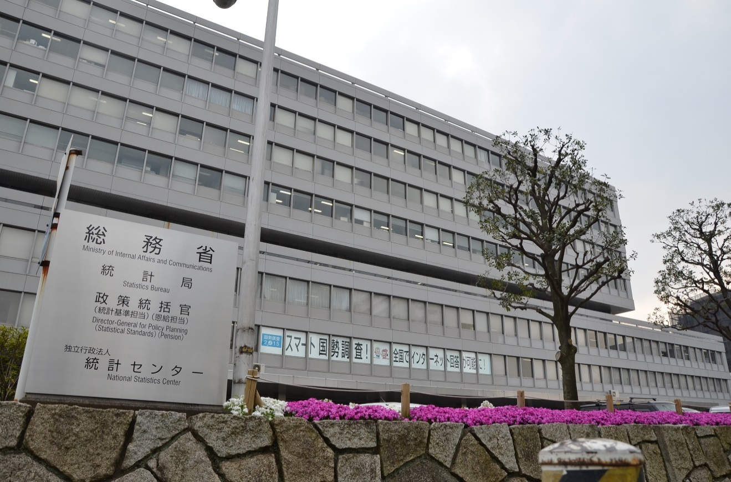
Thank you for your attention
Statistics Bureau,
the second government office of the Ministry of Internal Affairs and Communications,
19-1, Wakamatsu-cho, Shinjuku-ku, Tokyo 162-8668
Website on Statistics Bureau (http://www.stat.go.jp/english/index.html)
on the Economic Census (http://www.stat.go.jp/english/data/e-census.html)

