Slide 1
26th Meeting of the Wiesbaden Group on Business Registers
Session N.3 - Integrated Statistical Register Systems
Neuchâtel, 24 – 27 September 2018
The profile of entrepreneurs
in international trade businesses
P. Cella, C. Viviano
ISTAT, Italy

Slide 2
Contents:
Multiple sources of information on enterprises and people
The BD-TEC project and the new integrated data base
Linking entrepreneurs characteristics and enterprise group status
A taxonomy for exporter native/foreign-owned firms
The profiles of entrepreneurs of High-growth enterprises
Concluding remarks
The profile of entrepreneurs in international trade businesses
Neuchâtel, 24 – 27 September 2018

Slide 3
Background – The Integrated System of Registers (SIR)
SIR is «micro founded», it guarantees:
a single management on various issues (social, environmental, economic, etc.)
a conceptual and statistical integration
a physical integration of the statistical units that compose it
Consistency is assured by SIM (Integrated System of Microdata)
SIR consists of registers that refer to three main themes represented by:
population
production units
territory
The relationships between these themes allow us to connote it as a "system“ where consistency is assured
SIR is a system of statistical registers that centralize and integrate data derived from administrative sources and statistical surveys
The profile of entrepreneurs in international trade businesses
Neuchâtel, 24 – 27 September 2018

Slide 4
1. Multiple sources of information on enterprises and people
The system of satellite registers linked to SBR
BD
E-Ship
International Trade
SBR
Frame SBS
The profile of entrepreneurs in international trade businesses
Neuchâtel, 24 – 27 September 2018

Slide 5
2. The BD-TEC project and the new integrated data base
Goals: integrate information on export and imports with the business demography characteristics and enrich with the SBS data in order to produce information on the economic performance
Different statistical domains (SBS, BD, ITGS) data sources involved to cover 4 topics:
Topic 1: Linking business demography (BD) statistics to international trade in goods statistics by enterprise characteristics (TEC) to obtain information on export and imports of young enterprises.
Topic 2: Exploit other possibilities of the above linked BD-TEC dataset to analyze the enterprise population and shares of young enterprises by combinations of available breakdowns such as NACE, partner countries and type of trader.
Topic 3: Link the above dataset to business register (BR) and structural business statistics (SBS) to add additional characteristics, variables and breakdowns to the dataset in order to calculate indicators on the economic performance of young exporting and importing enterprises compared to other trading and non-trading enterprises in SBS.
The profile of entrepreneurs in international trade businesses
Neuchâtel, 24 – 27 September 2018

Slide 6
2. The BD-TEC project and the new integrated data base
Topic 4: Advance the methodology of micro data linking with respect to diverse issues such as linking registers and data sources based on sampling, effects on confidentiality and grossing up.
Example:
Labor productivity of enterprises by type of enterprises and sector (thousands of euro, year 2015)
The profile of entrepreneurs in international trade businesses
Neuchâtel, 24 – 27 September 2018

Slide 7
3. Linking entrepreneurs characteristics and enterprise group status
The system of satellite registers linked to SBR
BD
E-Ship
Leed Entrepreneurs
International Trade
SBR
Leed
Employment
Frame SBS
The profile of entrepreneurs in international trade businesses
Neuchâtel, 24 – 27 September 2018

Slide 8
3. Linking entrepreneurs characteristics and enterprise group status
Two themes relevant for the entrepreneurship study:
a) The behaviour of native/ foreign-owned businesses engaged in trading activities
b) The profile of entrepreneurs involved in high-growth firms
The profile of entrepreneurs in international trade businesses
Neuchâtel, 24 – 27 September 2018

Slide 9
4. A taxonomy for exporter native/foreign-owned firms
Question:
Do foreign people managing exporting firms have an advantage in foreign markets, especially those represented by their country of origin?
The profile of entrepreneurs in international trade businesses
Neuchâtel, 24 – 27 September 2018

Slide 10
4. A taxonomy for exporter native/foreign-owned firms
Taxonomy of companies:
Exporter
1) Companies managed by Italian entrepreneurs only
(87.8% of exporter companies and 92.4% of Non-exporter companies)
2) Companies managed by foreign entrepreneurs only
(2.9% of exporter companies and 0.6% of Non-exporter companies)
non-Exporter
3) Companies managed by both Italian and foreign entrepreneurs
(9.3% of exporter companies and 7% of Non-exporter companies)
The profile of entrepreneurs in international trade businesses
Neuchâtel, 24 – 27 September 2018

Slide 11
4. A taxonomy for exporter native/foreign-owned firms
For the exporting companies there is a very high correlation between the country of birth of the entrepreneur and the internal composition of the countries of birth of related labor force
The profile of entrepreneurs in international trade businesses
Neuchâtel, 24 – 27 September 2018

Slide 12
4. A taxonomy for exporter native/foreign-owned firms
numbers
2.7%
Total Exporter over the total population of active enterprises in Business economy
12.2%
managed by only and at least one foreign-born entrepreneur
55.9%
managed by only and at least one foreign-born entrepreneur and with hired at least one foreign employee
62.8%
Same country: entrepreneur/employee(s)
32.4%
Same country: entrepreneur/employee(s)/export
Focusing the attention on the population of firms in which the country of origin of entrepreneur coincides with the country of origin of at least one employee and one export country we analyze the distribution of export value by partner location
The profile of entrepreneurs in international trade businesses
Neuchâtel, 24 – 27 September 2018

Slide 13
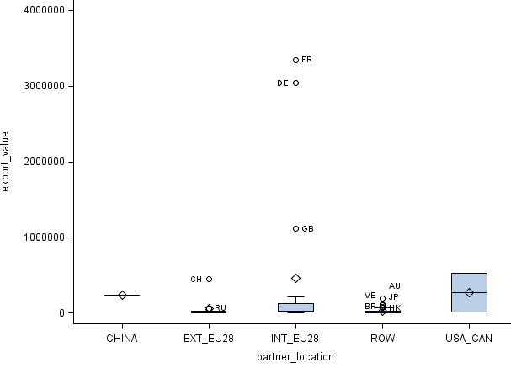
4. A taxonomy for exporter native/foreign-owned firms
Exporting companies
Same country of birth of
foreign entrepreneur,
employee(s) and at least
one export Country
The profile of entrepreneurs in international trade businesses
Neuchâtel, 24 – 27 September 2018

Slide 14
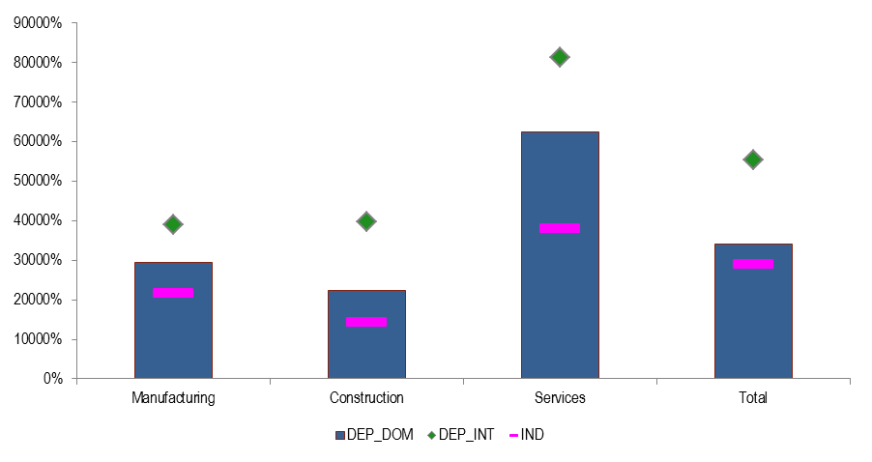
4. A taxonomy for exporter native/foreign-owned firms
The type of ownership affects the performance of enterprises that export, in fact multinational groups show an higher productivity in respect to the other types.
Figure 6- Productivity level of exporter enterprises managed by at least one foreign entrepreneur and with at least one foreign employee employment by group status and economic sector (thousands of euro, year 2015)
The profile of entrepreneurs in international trade businesses
Neuchâtel, 24 – 27 September 2018

Slide 15
5. The profiles of entrepreneurs of High-growth enterprises
For the entrepreneurs of high-growth enterprises four profiles have been identified:
- the first profile (18.7% of entrepreneurs), is related to entrepreneurs that are mostly adult (90.5%), with at least a diploma of secondary education (94%) and with a greater presence of foreigners (86.8% are Italian, 5.4 percentage points less than the average of 92.2%)
The profile of entrepreneurs in international trade businesses
Neuchâtel, 24 – 27 September 2018

Slide 16
5. The profiles of entrepreneurs of High-growth enterprises
- the second profile (39.4%) is characterize by entrepreneurs predominantly male (96.5), but, unlike the first cluster, they are older (93.3% are senior) with an above-average education (29.7% have at least a first degree)
- the third profile (25%) is mainly characterized by higher education (42.1% are graduates) and compared to previous ones, there is a higher component of women (although the majority are still men 68.7%)
- finally, the fourth profile (16.9%) concerns mostly female entrepreneurs (only 31.8% is male), younger (51.1% is under 35) mostly with diploma of secondary education (89.8%)
The profile of entrepreneurs in international trade businesses
Neuchâtel, 24 – 27 September 2018

Slide 17
6. Concluding remarks
The informative potential in using of integrated administrative and statistical data on businesses and on individuals
The central role of SBR in the linkage process of multiple sources
The possibility to define new taxonomies (classifications) for describing entrepreneurial profiles
The profile of entrepreneurs in international trade businesses
Neuchâtel, 24 – 27 September 2018

Slide 18
Thank you
cella@istat.it
viviano@istat.it
The profile of entrepreneurs in international trade businesses
Neuchâtel, 24 – 27 September 2018

