Slide 1

26th Meeting of the Wiesbaden Group on Business Registers
Session 5 New data Sources
Neuchâtel (Switzerland) - 24-27 September 2018
New sources for the SBR:
first evaluations on the feasibility
of using Big Data
in the SBR production process
Authors: Bianchi G., Consalvi M., Gentili B., Pancella F., Scalfati, Summa D.
Speaker: Monica Consalvi
Directorate for Economic Statistics - Istat, Italy

Slide 2
Contents
The Istat strategy from 2013
The scope of innovation and objectives of the BIGData project
Main steps of the first experimentation in the LabInn
Process model
First preliminary results
Lessons learnt and future developments
New sources for the SBR:
first evaluations on the feasibility of using Big Data in the SBR production process
Neuchâtel (Switzerland) - 24-27 September 2018

Slide 3
The Istat strategy from 2013
On-going projects on the use of Big Data:
  Persons and Places (Mobile Phone Data)
  Labour Market Estimation (Google Trends)
  On the use of ‘Scanner Data’ for estimating consumer prices
  Web-scraping techniques for the estimation of the use of Information and Communications Technology by companies and social media (Twitter, Facebook) for the estimation of confidence indicators.
Production of experimental statistics:
https://www.istat.it/en/experimental-statistics/experiments-on-big-data
to obtain a subset of the estimates currently produced by the sampling survey on yearly survey “ICT usage in Enterprises”.
Implementation of infrastructures and software for the treatment of Big Data (i.e. Sandbox and Cloudera) with projects involving enterprises, universities and research centres.
New sources for the SBR:
first evaluations on the feasibility of using Big Data in the SBR production process
Neuchâtel (Switzerland) - 24-27 September 2018

Slide 4


The Istat strategy from 2013
Three ESSnet on BigData – in the 3rd BIG DATA 2018-2020 Italy participates in 9 WPs
  In particular WP C – Implementation – Enterprise characteristics:
    Task 2 Methodological Framework/Guidelines
    Task 3 Experimental Statistics, including reference metadata
    Task 4 Starter Kit for NSIs
Mapping activity
Theoretical matrix ‘thematic areas–domains/phenomena’
In the last part of 2017 a preliminary analysis started on the feasibility of the acquisition and the possible use of web data for the SBR
Empirical matrix ‘thematic areas–keywords’
The new “Big Data usage to support the SBR” has been the first project to participate in the Laboratory for Innovation (LabInn) inaugurated on the 21st March 2018
New sources for the SBR:
first evaluations on the feasibility of using Big Data in the SBR production process
Neuchâtel (Switzerland) - 24-27 September 2018

Slide 5
The scope of innovation and objectives of the BigData project
The use of BIG DATA in support of the Statistical Business Register with the aim of integrating the ‘structured’ business data with the ‘unstructured’ data from web pages
The prototype will contain a set of enterprise-level information linked to the SBR, whose content allows:
Dissemination of a new experimental statistical output expanding the Statistical Business Register
Target 1: Increase quality of information in the SBR for improvement of sample designs
Target 2: Expanding informative content of the SBR (new items, documentation system)
The production of experimental statistics in addition to the traditional business statistics
Target 3: New business taxonomies (‘emerging’ populations, to be mapped over time)
New sources for the SBR:
first evaluations on the feasibility of using Big Data in the SBR production process
Neuchâtel (Switzerland) - 24-27 September 2018

Slide 6
Main steps of the first experimentation
URL from thematic directory sites
URL from batch queries on search engines (URL Retrieval with machine learning techniques)
2 – Identification of the enterprise
Text Mining techniques (including Natural Language Processing techniques) for extracting the information to integrate the Business Register (including metadata and .pdf file)
Machine Learning techniques for the use of algorithms that simulate a learning process for the construction of predictive models
1 – Acquisition of web addresses
URL from the admin sources (available only for 5% of SBR enterprises)
3 – Extraction and analysis of the information
Web Scraping techniques for web data acquisition
URL syntax validation, check of the recurring errors and domain extraction from URL
Detection of identification variables from the website (Fiscal code, VAT code, name, address…) trough the use of Information Retrieval techniques trough pattern matching on strings
Comparison with the same information available in the SBR register through matching techniques and string similarity metrics (Jaro-Winkler, Levenshtein, etc)
New sources for the SBR:
first evaluations on the feasibility of using Big Data in the SBR production process
Neuchâtel (Switzerland) - 24-27 September 2018

Slide 7
WHICH ENTERPRISES HAVE BEEN PART OF THE EXPERIMENTATION?
SBR
Reference population
sample
≈ 4.5 mln enterprises in t=2015
by economic activity:
9 classes of the high-level
SNA/ISIC aggregation A*10/11
of the NACE Rev.2 classification
≈ 1.6 mln enterprises
active in t=2015
Legal form = corporation/partnership
by size:
Size of the enterprises in terms of
employees and turnover
stratified by:
= 115,751 enterprises
Stratified sample with proportionate allocation (36 sample strata)
New sources for the SBR:
first evaluations on the feasibility of using Big Data in the SBR production process
Neuchâtel (Switzerland) - 24-27 September 2018

Slide 8
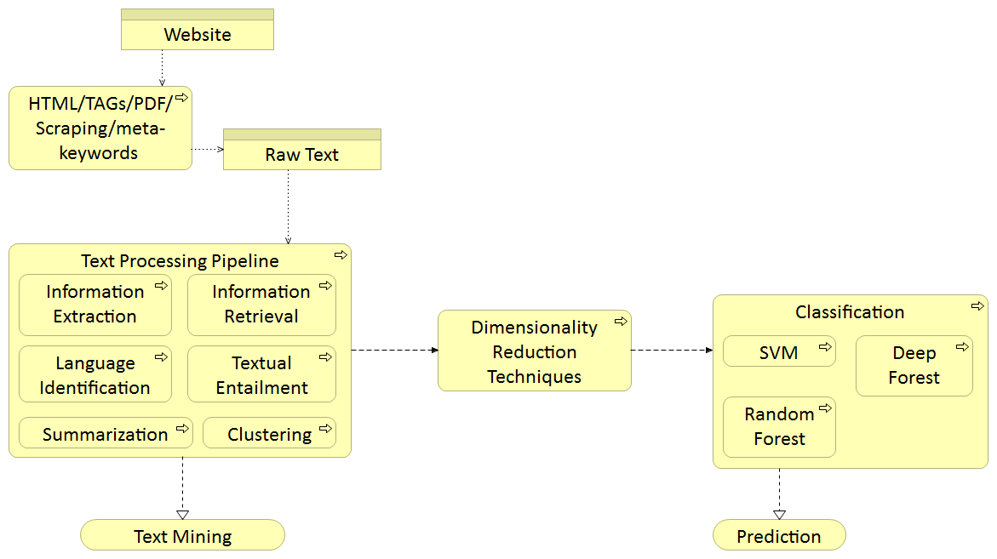
Process model
Web Scraping phase
Machine Learning
Text mining phase
New sources for the SBR:
first evaluations on the feasibility of using Big Data in the SBR production process
Neuchâtel (Switzerland) - 24-27 September 2018

Slide 9
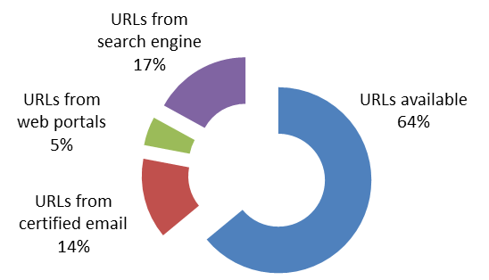
First preliminary results: the Web Mining process
Enterprises in the sample
by identified characters and by source of information for the URL
CHARACTERS | Total | URLs available from admin source | URLs from certified mails | URLs from web portals | URLs from search engine
Company name | 100,000 | 64 % | 14 % | 5 % | 17 %
Tax code/VAT number | 80,440 | 60 % | 9 % | 5 % | 26 %
Enterprise street address | 103,000 | 70 % | 8 % | 7 % | 15 %
E-mail Address | 198,000 | 60 % | 10 % | 3 % | 27 %
Telephone number | 230,000 | 63 % | 8 % | 7 % | 22 %
Company capital | 21,580 | 40 % | 4 % | 35 % | 21 %
Presence on Social Media | 131,830 | 65 % | 9 % | 6 % | 20 %
Presence of online job application facilities | 15,000 | 52 % | 16 % | 2 % | 30 %
how the enterprises
of the sample
achieved the URLs:
New sources for the SBR:
first evaluations on the feasibility of using Big Data in the SBR production process
Neuchâtel (Switzerland) - 24-27 September 2018

Slide 10





First preliminary results
Addresses by type of local unit
Enterprises by presence on social media
Type of local unit | %
Addresses related to administrative headquarters | 70
Addresses related to other local units | 30
E-mail addresses by type of address
Type of address | %
E-mail address | 92
Certified e-mail address | 8
Phone numbers by type
Type of phone number | %
Phone | 58
Mobile phone | 12
Fax | 30
Online job facilities | %
Enterprises WITH online job application facilities | 15
Enterprises WITHOUT online job application facilities | 85
New sources for the SBR:
first evaluations on the feasibility of using Big Data in the SBR production process
Neuchâtel (Switzerland) - 24-27 September 2018

Slide 11

Lessons learnt and future developments
Traditional systems of data collection and data processing no longer adequate
Difficulty to manage rapidly growing volumes of data resulting in a high consumption of computing and storage resources
Other technical limits to solve: the long run time necessary for the crawler to get the entire content; the restrictions caused by the security barriers inside the website preventing automatic access
Statistical problems: the difficulty of certifying the quality of information and the data reliability; how to attribute information with certainty to an SBR enterprise; how to classify with certainty the universe to which a set of data extracted from the web belongs
New sources for the SBR:
first evaluations on the feasibility of using Big Data in the SBR production process
Neuchâtel (Switzerland) - 24-27 September 2018

Slide 12

Lessons learnt and future developments
enriching statistical production with new information;
increasing the timeliness of statistical products in a short time;
increasing the relevance of business statistics at a lower cost than enlarging the existing data;
the web is an independent source of data → representation closer to reality.
New sources for the SBR:
first evaluations on the feasibility of using Big Data in the SBR production process
Neuchâtel (Switzerland) - 24-27 September 2018

Slide 13


Lessons learnt and future developments
New opportunities involve new challenges and still open questions:
when and how it would be necessary to repeat the extraction of the same data from the web (cyclic monitoring to capture the differences?);
when differences can be considered significant as true changes;
how to get the “date” in which the change takes place;
respect for privacy;
the need to acquire new infrastructures (methodological, technological, organizational ones), as well as new skills;
the main challenge is to move from experimentation to production.
New sources for the SBR:
first evaluations on the feasibility of using Big Data in the SBR production process
Neuchâtel (Switzerland) - 24-27 September 2018

Slide 14
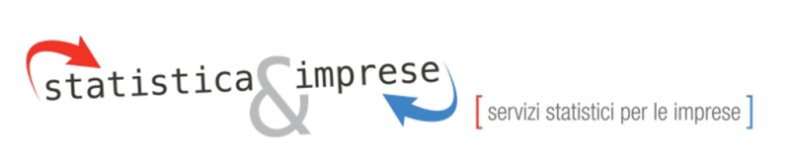
The new integrated system of ASIA registers
Administrative Sources
Financial Statement and note
ASIA
Local Units
FARM REGISTER
Fiscal sources
Chamber Commerce
Social Security
Sectoral, Public Administration
Big Data
…..
Statistical Sources
The Business Portal:
ASIA
Enterprises
Microdata
integration
process
PA
ASIA Enterprise Groups
Non PROFIT
S13
ASIA Employment
EGR
New sources for the SBR:
first evaluations on the feasibility of using Big Data in the SBR production process
Neuchâtel (Switzerland) - 24-27 September 2018

Slide 15
Lessons learnt and future developments
INPUT
Big data
DATA DRIVEN approach
OUTPUT
Standard traditional processes of Official Statistics
Output oriented approach
The challenge:
A register-based approach to the analysis of BIG DATA
New sources for the SBR:
first evaluations on the feasibility of using Big Data in the SBR production process
Neuchâtel (Switzerland) - 24-27 September 2018

Slide 16

Factors for Success: the multi-dipliscinary context
High interaction among experts (they work contextually, side by side)
It requires managing connections among separated departments
Integration of different skills and expertise
Shared competence base
(a good training is essential)
Thematic expert:
governs the process, raises the problem and indicates its requirements, validates the results. He/she does not know in advance the contents coming from the web
Methodological expert:
Analyses the requirements of the problem and finds the methodological solutions
IT expert:
provides the tools and techniques and turns specifications into procedures
New sources for the SBR:
first evaluations on the feasibility of using Big Data in the SBR production process
Neuchâtel (Switzerland) - 24-27 September 2018

Slide 17

Monica Consalvi (moconsal@istat.it)
Barbara Gentili (bagentil@istat.it)
Flavio Pancella (pancella@istat.it)
Gianpiero Bianchi (gianbia@istat.it)
Francesco Scalfati (scalfati@istat.it)
Donato Summa (donato.summa@istat.it)

