Slide 1

26th Meeting of the Wiesbaden Group on Business Registers
Session 6 Profiling and Globalisation
Neuchâtel (Switzerland) - 24-27 September 2018
The implementation of
ISTAT automatic profiling
to support the delineation of
complex enterprises
Authors: Francesca Alonzi & Serena Migliardo
Presenter: Serena Migliardo
Directorate for Economic Statistics - Istat, Italy

Slide 2
Contents
Introduction
Legal, economic and statistical framework of complex enterprises
Automatic profiling: strategy, groups’ structure, simple groups and complex groups
Italian BR groups structures and impact of automatic profiling
The representative unit
Conclusions and future developments
The implementation of ISTAT automatic profiling
to support the delineation of complex enterprises
Neuchâtel (Switzerland) - 24-27 September 2018

Slide 3
Introduction
Globalization calls for comparable statistics in Europe and around the world, thus necessarily implying a combination between the pure economic view of business groups and the statistical treatment of enterprises groups.
Manual and automatic profiling techniques go in this direction.
Objective of the contribution:
to describe the methodology, developed by ISTAT, to automatically delineate the new statistical units (ENTs) by exploiting economic theories on groups’ structures;
to offer a first contribution on the identification of a ‘representative legal unit’ among the set of legal units combined together to form the ENT, able to donate principal attributes to the ENT.
The implementation of ISTAT automatic profiling
to support the delineation of complex enterprises
Neuchâtel (Switzerland) - 24-27 September 2018

Slide 4
Legal, economic and statistical framework of complex enterprises
The contribution offers an overview on the legal, economic and statistical framework on complex enterprises with the aim of providing the reader with a reference background on the phenomenon.
The literature and the economic management theory have identified various types of business groups even if vigorous academic discourse about this organizational form is ongoing (Khanna and Palepu, 2000); for example, as noted by Yiu et al. (2005), recent studies have traced the evolution of business groups in regard to pattern of diversification and organizational structure over time (Kim et al., 2004; Kock and Guillén, 2001). In effect, both economic and juridical studies have identified the key elements of the “group” as an organizational structure: the presence of a plurality of legal entities and the control of such entities by a sole entity (Di Carlo, 2009).
The implementation of ISTAT automatic profiling
to support the delineation of complex enterprises
Neuchâtel (Switzerland) - 24-27 September 2018

Slide 5
Automatic profiling - strategy
Automatic profiling developed by ISTAT to delineate the Enterprise by linking together not autonomous resident legal units belonging to the same group, exploits the organizational structures of organizations in line with a theme first explored by Chandler (1962), the existence of an intimate relationship between the strategy of the firm and its organizational structure.
Two steps:
analysing group’s structures in terms of legal units and organization control level;
measuring a set of economic aggregates to identifying the new potential ENTs.
The methodology requires:
an integrated base of micro-data which link together different national data sources;
ad hoc correspondence matrices to link potential ancillary and integrated units.
… being focused on the target population of SBS legal units belonging to SBS Groups.
The implementation of ISTAT automatic profiling
to support the delineation of complex enterprises
Neuchâtel (Switzerland) - 24-27 September 2018

Slide 6
Automatic profiling - groups’ structure
More than 80% of Italian SBS groups have an elementary structure with a maximum of 3 resident active legal units in SBS target population; the population of enterprise groups is divided into two segments:
simple groups - if the total number of SBS legal units is ≤ 3;
complex groups - if the total number of SBS legal units is > 3.
The basic assumption of this choice lies on the fact that the internal structure of groups in terms of relationships and control level is not relevant for simple groups, while it may be significant in the case of complex groups.
For complex groups, for which no intensive or desk profiling activity is planned due to internal/organizational constraints, automatic profiling has to be undertaken.
The implementation of ISTAT automatic profiling
to support the delineation of complex enterprises
Neuchâtel (Switzerland) - 24-27 September 2018

Slide 7
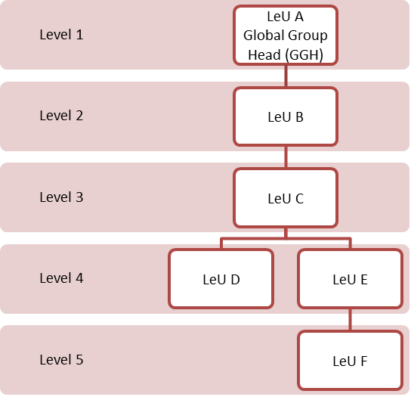
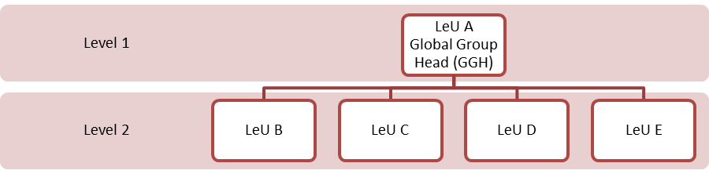
Automatic profiling - groups’ structure
Example of a group with a predominantly vertical structure
Depending on the structure of the groups of enterprises to be profiled, automatic algorithms slightly differ in the treatment and delineation of the statistical units.
The groups’ morphology, in an economic perspective, is the base for the statistical interpretation of the phenomenon:
groups with a ‘mainly vertical structure’;
groups with a ‘predominantly horizontal structure’;
groups with a matrix structure, articulated
both horizontally and vertically.
Example of a group with a pure horizontal structure
The implementation of ISTAT automatic profiling
to support the delineation of complex enterprises
Neuchâtel (Switzerland) - 24-27 September 2018

Slide 8
Automatic profiling - simple groups
Identification of ‘mono-activity groups’
1 Group = 1 SBS ENT
NACE 4-digit level
Value added (VA), Turnover and Persons employed, all being considered at group level.
A group is considered as a mono-activity group (1 Group = 1 SBS ENT) if at least 90% of the value of the chosen economic variable (in order VA, Turnover, Persons employed) is concentrated in only one economic activity at NACE four-digit level.
If the threshold is lower than 90%, ancillary or vertical integrated activities have to be considered.
If the sum of the principal activity, the ancillary or/and the integrated activity is >=90%, the groups can be considered as being mono-activity groups.
Simple groups which are not solved as mono-activity groups are considered as multi-activity groups (1 Group = more than 1 SBS ENT).
The implementation of ISTAT automatic profiling
to support the delineation of complex enterprises
Neuchâtel (Switzerland) - 24-27 September 2018

Slide 9
Automatic profiling - complex groups
Mono-activity
groups
In case of mono-activity complex groups, the complex enterprise (ENT) will be easily created (1 Group = 1 ENT), otherwise the indicator on the groups’ structure has to be considered.
Groups’ structures
indicators
Groups with vertical and horizontal structures are treated as simple groups and considered as multi-activity groups (1 Group = more than 1 SBS ENT); for groups with a matrix structure there is the need to automatically identify the existence of vertical or horizontal sub-groups able of representing autonomous enterprises.
Iterative algorithm
Groups has to be broken in sub-groups, by an iterative algorithm; starting from the second level of the group’s structures, such algorithm turns and breaks the structures up to bring them back to horizontal or vertical structures. Finally, the condition of mono-activity groups is re-applied on the new sub-structures.
The implementation of ISTAT automatic profiling
to support the delineation of complex enterprises
Neuchâtel (Switzerland) - 24-27 September 2018

Slide 10
Italian BR groups structures and impact of automatic profiling
Sector of activity | As Is |  | To be |  | Impact (var %)
 | Number of LeUs (a) | Employm. of LeUs (c) | Number of ENTs (b) | Employm.of ENTs (d) | Impact on LeUs (b-a)/a*100 | Impact on employm. (d-c)/c*100
Industry | 76,716 | 1,935,738 | 56,056 | 1,955,402 | -26.9 | 1.0
Wholesale | 43,091 | 901,796 | 32,299 | 917,939 | -25.0 | 1.8
Services | 125,107 | 1,748,392 | 73,395 | 1,715,144 | -41.3 | -1.9
Holdings | 11,631 | 4,175 | 2,289 | 1,617 | -80.3 | -61.3
Total | 256,545 | 4,590,102 | 164,039 | 4,590,102 | -36.1 | 0.0
The implementation of ISTAT automatic profiling
to support the delineation of complex enterprises
Neuchâtel (Switzerland) - 24-27 September 2018

Slide 11
The representative unit
The algorithm of automatic profiling individuates the representative unit as the legal unit carrying out the principal economic activity measured in terms of economic variables used for the delineation of the ENT, being in order: value added, turnover and number of persons employed.
Additional indicators
Status of activity – If only one of the legal units is active, it is considered to be the representative.
Legal form – When the legal units have different legal forms, it is preferred the legal unit which is a limited company.
Level – If the legal units occupy different levels in the group structure, the representative unit may be the one with the highest level.
NACE code at 5 digits – In general, in the classification ATECO 2007, the national version of NACE Rev. 2, the higher is the category (5th digit) the less important (secondary) is the economic activity.
The implementation of ISTAT automatic profiling
to support the delineation of complex enterprises
Neuchâtel (Switzerland) - 24-27 September 2018

Slide 12
Conclusions and future developments
Manual profiling activity is more than ever occupying a core position in ISTAT.
Next year goal is to manually profile more than 80 groups and collect intra-flows data through an ad hoc SBS survey.
However, Italy is characterized by the presence of a large number of complex enterprises, that can not all be delineated with only manual profiling approaches. Automatic profiling is a good method too, if all the necessary information on the organizational structure of the groups are available from the system of Business Registers (BR).
The implementation of the new ENT definition imply a full revision of the BR updating process in terms of new procedures, new software, new tables and new variables.
It also involves the need to define a new process for assigning the enterprise identification code and to maintain it (new continuity rules).
The implementation of ISTAT automatic profiling
to support the delineation of complex enterprises
Neuchâtel (Switzerland) - 24-27 September 2018

Slide 13
Thank you for the attention
Serena Migliardo (migliard@istat.it)
Francesca Alonzi (alonzi@istat.it)
Directorate for Economic Statistics - Istat, Italy
The implementation of ISTAT automatic profiling
to support the delineation of complex enterprises
Neuchâtel (Switzerland) - 24-27 September 2018

