Slide 1
26th Meeting of the Wiesbaden Group on Business Registers Session 4 : Administrative Data
The French Business Register for the economic restructuring
Olivier Haag
Insee

Slide 2
Outlines
What are we talking about?
An overview of CITRUS
The CITRUS workflow
The main contribution of the administrative data
The CITRUS output
How taking into account the enterprises in CITRUS?

Slide 3
What is an economic retructuring?
Activity transfers between legal units
The most common cases
Absorbtion
Merger
LeU X
LeU X
LeU Y
disapears
LeU X
disapears
LeU Z
New ID
LeU Y
disapears

Slide 4
What is an economic retructuring?
Scission
partial contribution of assets
LeU X
LeU X
LeU Y:new
LeU Z:new
LeU X
LeU X
LeU Y
LeU Y

Slide 5
What are the impacts on the business statistics?
For longitudinal studies
Can generate atypical temporal evolution
Blur the message for sectorial analysis

Slide 6
What are the impacts on the business statistics?
Example of a merger

Slide 7
How taking them into account?
Decomposition of the sectotial evolution by population
The sustainable enterprises (P)
The business demography (pure creation (N) – cessation (M))
The inflows (EC) – the outflows (SC)
These 3 catégories can be directly indentified by the French NSBR
The enterprises involved in an economic restructuring
This category cannot be indentified by the French NSBR => we need more information
Implementation of a specific BR for the economic restructuring

Slide 8
CITRUS : the BR of economic restructuring
Collects administrative and statistical data about restructuring (couple of legal units)
Creates a new statistical unit called envelope to neutralize the effects of the restructuring
Includes the legal units which participate to the restructuring for the current year and the year before
Tries to produce the same structure for the year “Y-1” (before the restructuring) than for the year “Y” (after the restructuring)

Slide 9
Which impacts on the business statistics?
Example of a merger
envelope
This flow must be eliminated because it disapears after the restructutring
Nace code of the envelope A
for 2017 and 2016

Slide 10
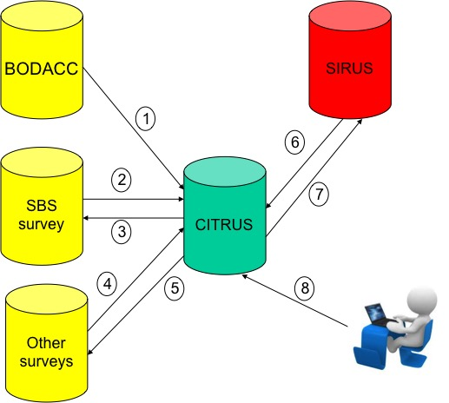
The CITRUS workflow

Slide 11
The administrative source
The Official Bulletin of Civil and Commercial Advertisements (BODACC)
The publicity of deeds registered in the Trade and Legal units Register
Data come from the registries of the commercial courts
Insee downloads daily XML files from this open data web site

Slide 12
The administrative source
The information we need, are not directly available
Keep only announcements that contain keywords associated with a restructuring
Then, we aim at identifying
the identifier of the legal unit "beneficiary" and ceding
the type of restructuring: split, partial transfer of assets, absorption…
the dates of the restructuring
the amounts exchanged

Slide 13
The administrative source
Gives an important part of the information (77% of the LeU in restructuring)
Gives up-to-date information (60% of the total number of BODACC files are known no later than 30 days after the decision date)
Can be used for short term statistics analyses

Slide 14
Statistical sources
SBS survey
legal units undergoing restructuring are automatically included in the take all strata
to complete the missing information of the BODACC (mainly the amount of the transfers)
Other surveys
No specific question
Information when the clerks contact the enterprises

Slide 15
The output of CITRUS
CITRUS provides three types of outputs
The list of legal units which participate to a restructuring for a given year
The amounts exchanged during the restructuring: useful to calculate the real investment of the legal units
The envelope’s data

Slide 16
The envelope’s data
a legal unit belongs to one and only one envelope for a given year
the perimeter of the envelope
Legal unit in the entry of restructuring which will be used to calculate the Y-1 data
Legal unit in exit which makes it possible to calculate the Y data
the Nace code for the envelope
an aggregation coefficient: use to neutralize flows between units present (respectively absent) before restructuring and having disappeared (respectively appeared) after the restructuring

Slide 17
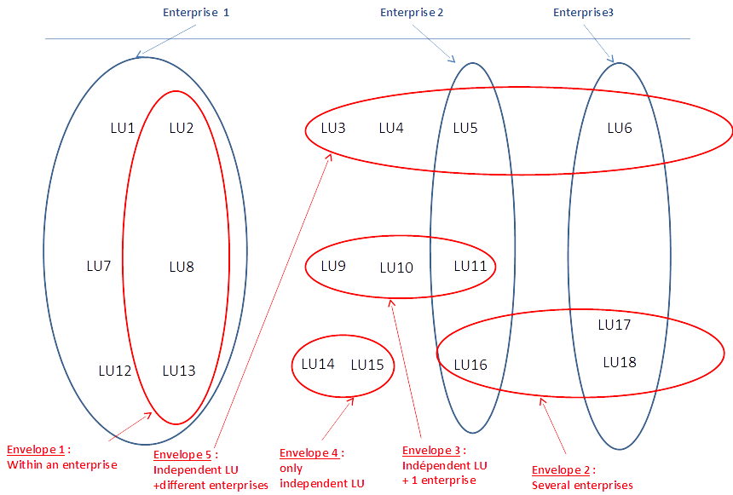
The envelope in enteprises

Slide 18
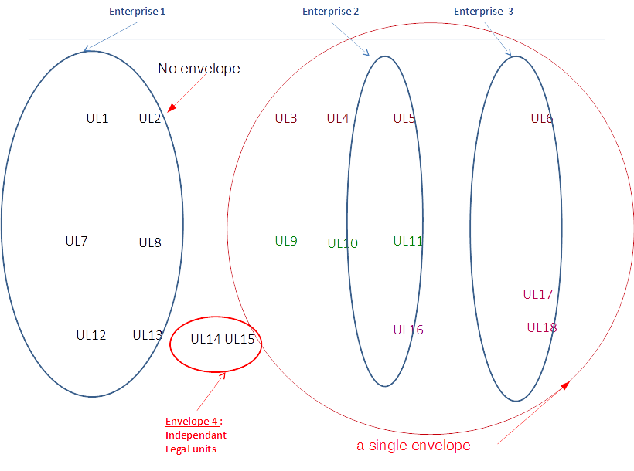
The envelope in enteprises

Slide 19
Conclusion
CITRUS provides information about restructuring
To improve the relevance of the temporal controls of the surveys data
To improve the quality of the investment data
To calculate aggregates in a comparable evolution and at a constant field
Useful for Early Warning System
The contribution of the administrative source is undeniable to identify units undergoing restructuring within very short deadlines

Slide 20
Thanks for your attention Some Questions ?
The French Business Register for the economic restructuring

