Slide 1
Profiling in germany – evaluation of the first test year
26th Wiesbaden Group, Neuchâtel, 24-27 September 2018
Session 6: Profiling and Globalisation
Simon Rommelspacher, Germany

Slide 2
Agenda
Introduction
Organisation of profiling in Germany
Evaluation of the first test year
Key findings
Outlook
References

Slide 3
1. Introduction
Profiling of enterprises: new task of the statistical business register
Two test years for:
    Methodology
    Organisation
    IT tools and templates
Evaluations of each test year
Findings, measures and improvements for the next profiling test cycle and the ‘Go live’ of profiling in Germany

Slide 4
2. Organisation of profiling in Germany
Desktop profiling
  Describing the structure
  Analysing and identifying the enterprises
Approx. 35 manual Profilers of the 14 Statistical Offices of the Laender
Profiling service desk in the Federal Statistical Office
  Coordination
  Methodological development
Intensive profiling in the second year
intensive profiling
desktop
profiling
automatic
profiling
manual
profiling

Slide 5
2. Organisation of profiling in Germany
Results of a manual profiling case:
  Profiling report (text-based)
  excel-application (microdata)
  Business Register data base (core Information of enterprises)
Excursus: profiling data processing in Germany

Slide 6
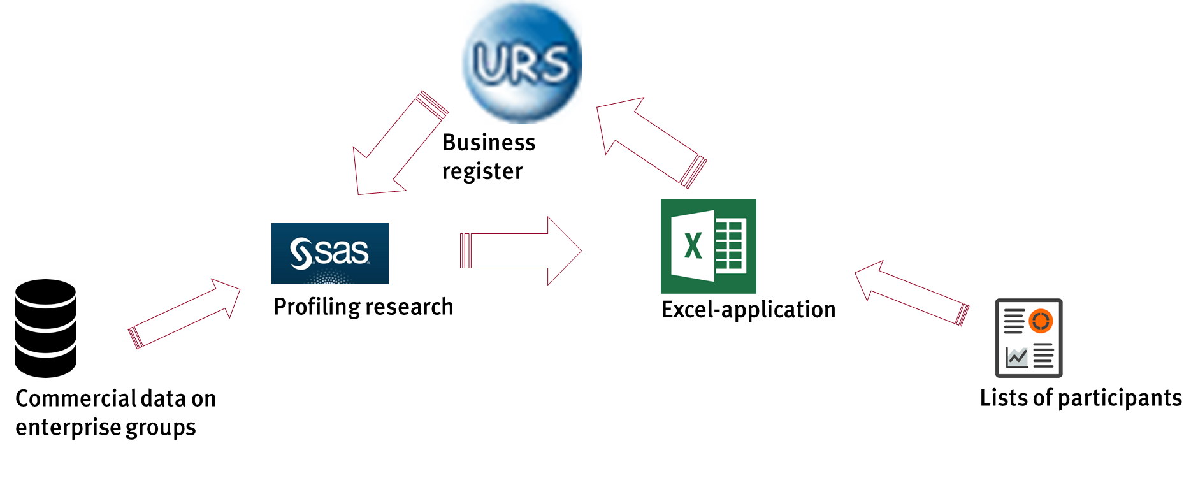
Excursus: profiling data processing

Slide 7
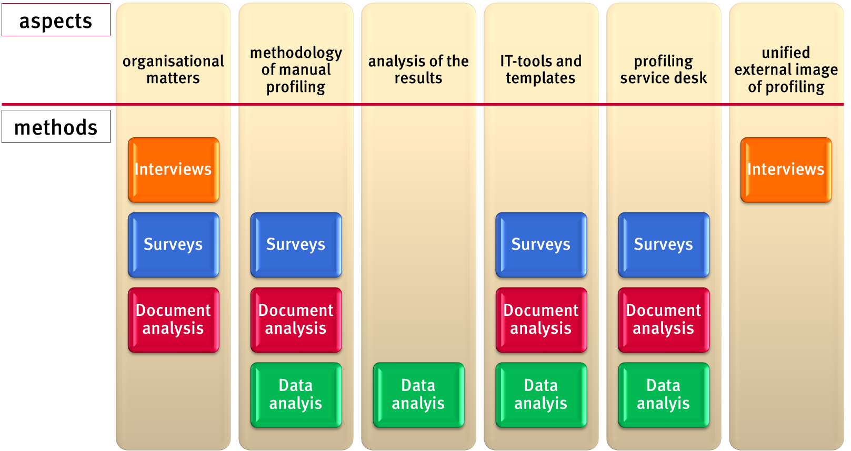
3. Evaluation of the first test year

Slide 8
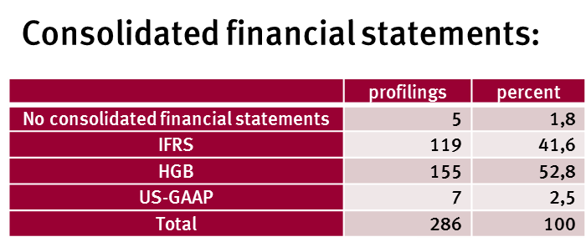
4. Key findings
288 manual profiling cases in the first test year

Slide 9
4. Key findings
Organisational matters:
Good communication channels for all profiling employees in Germany
Transparency of the profiling results
Methodology of manual profiling:
Profiling of the whole enterprise group is sometimes complicated
Consolidated financial statements and websites are good sources
Accounting criterion and the NACE-Code for enterprises can be difficult

Slide 10
4. Key findings
IT-tools and templates
Profiling report is optimised for the second test year
Excel-application is extended with more functions and graphics
Focus on the results in both tools
Profiling service desk:
Communication platform is very important
Practical profiling results are helpful for further methodological development
Communication is a precondition for coordination of profiling activities

Slide 11
5. Outlook
The quality of the manual profiling method is to be improved by all measures taken from the evaluation of the first test year
The second year of testing will be re-evaluated and analysed again
Intensive profiling will be developed, tested and evaluated in the second year
Knowledge gained from manual profiling will be used for further developments of the delineation rules in automatic profiling
‘Go live’ of profiling in Germany in June 2019

Slide 12























Thank you for your attention!
Federal Statistical Office of Germany
Simon Rommelspacher
email: simon.rommelspacher@destatis.de

Slide 13
5. References
European Union (1993): Official Journal of the European Communities, COUNCIL REGULATION (EEC) No 696 / 93, 1-10.
Opfermann, R.; Beck, M.(2018): Einführung des EU-Unternehmensbegriffs, WISTA Wirtschaft und Statistik Ausgabe 1/2018, 63-76.
Redecker, M.; Sturm, R. (2017): Profiling von Unternehmen, WISTA Wirtschaft und Statistik Ausgabe 6/2017, 9-26.
Sturm, R.; Redecker, M. (2016): Das EU-Konzept des Unternehmens, WISTA Wirtschaft und Statistik Ausgabe 3/2016, 57-72.

