Slide 1
FSO Data Innovation Strategy
Prof. Dr. Bertrand Loison
Vice-Director, Head of Division Registers
Wiesbaden Group, Neuchâtel, 19 - 21 September 2018
Notes:
Good afternoon everybody,
I would like to express my thanks for inviting me to this session. It’s really a great pleasure being part of these four days with Business Register experts from all around the world which share experiences and good practices.
For those who don’t know me, my name’s Bertrand and I’m in charge to run the division Registers at FSO.
The focus of my presentation … linked with Diego

Slide 2
Agenda
The FSO’s answers to the digitalisation era
The FSO’s data innovation strategy
Pilot projects
Conclusion
Notes:
I divided my talk into four parts.
First I’ll tell you about the big picture. After this part, you should be able to understand how we are dealing with the digital era.
From there I’ll cover the approach that we have to integrate new data sources into our production processes.
Then I’ll briefly present our five pilot projects.
Lastly, I’ll emphasize the steps that are needed for the FSO… Meaning people, skills, communication and so on.

Slide 3
Agenda
The FSO’s answers to the digitalisation era
- Data collection (input)
- Data processing (throughput)
- Data dissemination (output)
The FSO’s data innovation strategy
Pilot projects
5. Conclusion
Notes:
To do that, I’ll go through the points mention on the slide.

Slide 4
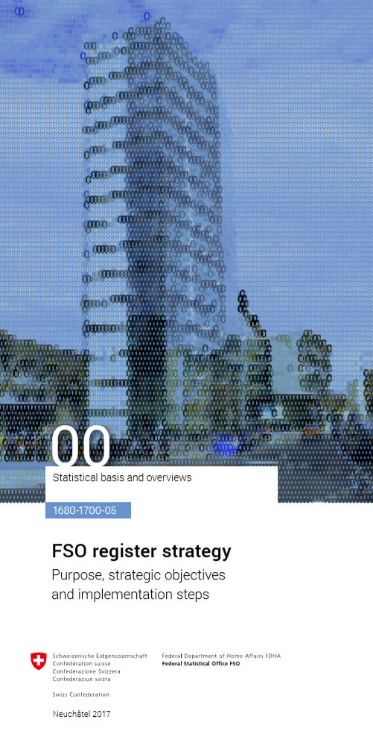
Data collection (input)
The FSO has been in the digital era for over 10 years. New data sources (big data) are simply the next step… but a major one !
Surveys
1
Registers and
administrative data
2007
2
4
New data sources
(big data)
2017
3
Notes:
Now I’ll tell you more about the point of view of the input. That means from a data collection point of view.
First of all, it’s important to understand that FSO sees the topic “New Data Sources.” as a logical step, that means an important one, with many challenges but still, a logical step that started many years ago.
In fact, it started more than one decade ago when we decided to integrate administrative data in our current production. To achieve this, FSO published the register strategy that aims to reduce administrative burden by using administrative data. More than ten years after the launch of this strategy we are still facing challenges with administrative data. That means quality, use of statistical models, and so on.
Like we did in 2007, we published last year our data innovation strategy which is the FSO’s response to the challenge of integrating new data sources in our current production.
The first key competence that an NSI needs to have is the skills, knowledge, and expertise to integrate data from different sources. It’s not just a technical aspect like buying a good ETL tool but also the capacity to deal with structured and non-structured data. This task can not be delegated to the IT division and must be executed by statisticians.

Slide 5
Data collection (input)
According to the Federal Statistics Act, the institutions of federal statistics must limit the administrative burden on data suppliers (individuals, enterprises and authorities).
To this end, since 2007 the FSO has implemented a strategy to use administrative data that already exists within the public administration wherever possible instead of conducting surveys (on paper, online or by telephone).
The data innovation strategy aims to apply complementary analysis methods (e.g. predictive analysis by advanced statistical techniques, data science and/or automatic learning) to the FSO's primary sources and identifiable secondary sources already crossed (if they are already used in the FSO's current statistical production, to additional secondary data already used at the FSO and to new secondary sources (not used at the FSO so far).
Notes:
As mentioned before. We defined two strategies. The first one… the register strategy had and has a clear goal. That means reducing administrative burden by using administrative data. The law in Switzerland is very clear about this point. No surveys (paper, phone or internet) must be launched if the same information can be provided by administrative data, data matching or the use of statistical models.
The second one is the data innovation strategy which aims to apply complementary analysis methods (e.g. predictive analysis by advanced statistical techniques, data science and/or automatic learning) to the FSO's primary sources and identifiable secondary sources already crossed.
Both strategies are available online. I’ll tell you more about the second one in a few minutes.

Slide 6
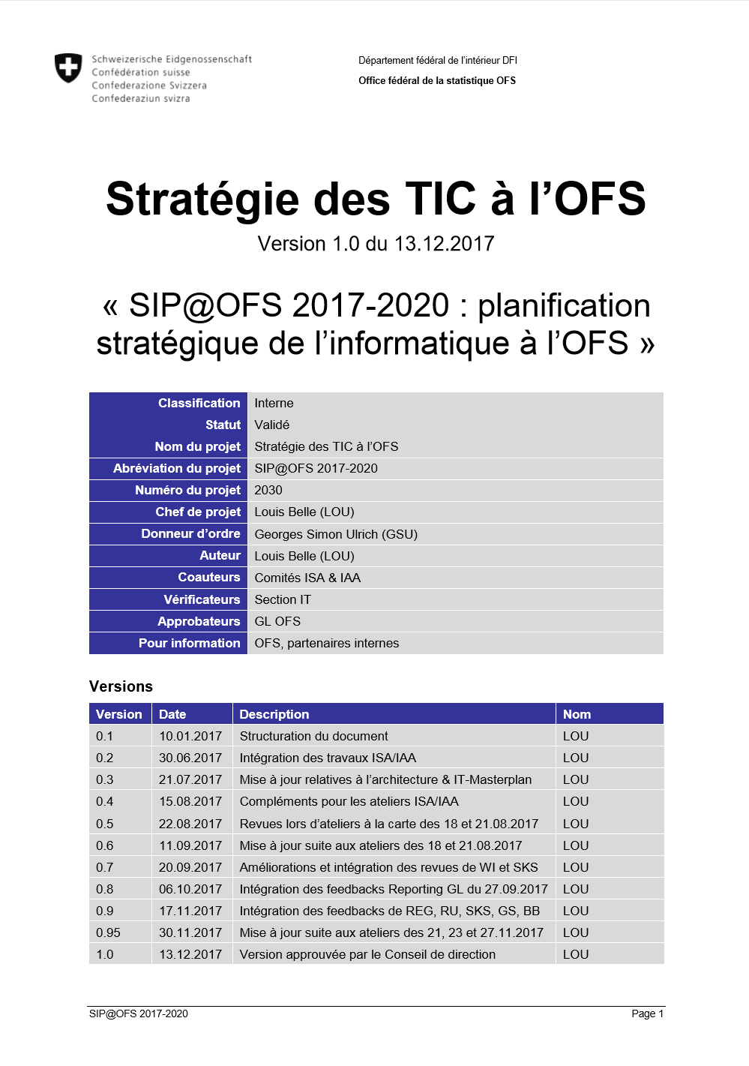
Data processing (throughput)
Between 2008 and 2010, the FSO developed a corporate Statistical Information System (SIS ver. 1.0) to fit the challenges of register based statistics. A new SIS release (SIS ver. 2.0) is currently being developed to fit the needs of new data sources.
2010
2017
Surveys
1
Statistical Information
Systems (SIS)
+
Complementary
analysis methods
5
Registers and
administrative data
2007
2
4
6
The FSO has adopted a new data innovation strategy. This constitutes the first response by official statistics to the challenges posed by the digital revolution.
New data sources
(big data)
2017
3
2017
Notes:
Now, we have to move to the central part of the production process. That means “throughput” or in other words to focus on the process that transforms raw data into data that is fitting for statistical analysis. Two mains pieces need to be concerned.
The first one is our statistical information system. This system was built more or less ten years ago to fit the challenges of register-based statistics. That means taking into account the constraints of integrated statistics, data protection, and traceability. Now we are currently trying to define a new version of our SIS that should fit with the requirements of integrating new data sources (Big Data,…) into our statistical production. Believe me when I say that it’s not an easy task. I could spend hours to explain this, but it’s not the purpose of this conference.
The second one is our data innovation strategy. Precisely the fact that we need to apply complementary analysis methods (e.g., predictive analysis by advanced statistical techniques, data science and/or automatic learning) if we want to be able to use new data sources like Twitter, Facebook, LinkedIn, Satellite Imageries, and so on in our statistical production. That’s the hard part of the game because FSO is not currently using these methods at all. That means we need to acquire new skills; rethink our production processes, and last but not least to integrate the inductive approach in our statistical thinking. We have five pilots projects that are currently running to evaluate if the official statistical can benefit from data science and machine learning approaches.
As you can see, the FSO is still trying to capitalize on what was built many years ago. We need to protect our past investment, evaluate what could be the benefit of these new data sources for official statistics and not take every technical hype for granted, and big data is still a little bit a technical hype that we need to demystify and understand as scientists have learned to do it.

Slide 7
Data processing (throughput)
The aim of the SIS ver. 2.0 program is to set up a statistical information system (SIS) which takes into account the constraints of integrated statistics, data protection and traceability.
This system must be in line with the FSO’s added value creation process and must make available to all of the FSO’s productive organisational units, all data providers and all kinds of data sources the functions that they need.
The data innovation strategy aims to apply complementary analysis methods (e.g. predictive analysis by advanced statistical techniques, data science and/or automatic learning) to the FSO's primary sources and identifiable secondary sources already crossed (if they are already used in the FSO's current statistical production, to additional secondary data already used at the FSO and to new secondary sources (not used at the FSO so far).
Notes:
Now, you can have a look at the two documents that I mentioned on the previous slide. If you are interested, you can find both on the Internet. Please go to our homepage www.bfs.admin.ch and use our search engine. If you can’t find it, please let me know, and I’ll send you by email.

Slide 8
Data dissemination (output)
In 2017, the FSO renewed its output strategy to respond to the challenges posed by the digital era (e.g., Twitter, LinkedIn, etc.) but also to the use of web services for data dissemination.
Social medias
2010
9
2017
Surveys
1
Web services
9
Statistical Information
Systems (SIS)
+
Complementary
analysis methods
5
Registers and
administrative data
2007
2
4
7
Internet
+
OGD
6
8
New data sources
(big data)
2017
3
Paper
8
2017
Notes:
Finally, we have to move to the last part of the production process. That means the “output.” It’s not the purpose of my presentation. I put this slide in because it seems important to me to tell you that from the whole organization we also initiated many changes to increase the time to market and the way we disseminate our statistics.

Slide 9
Agenda
The FSO’s answers to the digitalisation era
The FSO’s data innovation strategy
- What is data innovation ?
- Strategic objectives
- How did FSO define primary and secondary data ?
- Why is the inductive-deductive reasoning cycle so crucial ?
4. Pilot projects
5. Conclusion
Notes:
To present our data innovation strategy, I’ll go through these five points.

Slide 10
What is Data Innovation ?
FSO defines data innovation as the application of complementary analytics methods (e.g. predictive analytics using approaches from advanced statistics, data science and/or machine learning) to existing (or traditional) and/or new (or non-traditional) data sources to sustain the role of official statistics in the democratic process in Switzerland by ensuring that the information we provide remains reliable, transparent and trustworthy.
Notes:
The first thing that we did… was to define data innovation because the literacy doesn’t really address the point. The point that our strategy did is to underline that you don’t need to have big data like twitter, facebook and so on to run data innovation… data from surveys and also administrative data are valuable assets – that means data that we know – to apply complementary analytics methods like predictive analytics using data science and/or machine learning algorithms.

Slide 11
Strategic objectives
Strategic objective 1
Develop data innovation guidelines and investigate the feasibility of the application of complementary analytics methods to existing (or traditional) and/or new (or non-traditional) data sources, along with the goal of augmenting and/or complementing any existing basic statistical production for which data innovation makes sense.
Strategic objective 2
Develop and implement FSO internal and external communication measures to increase awareness of the added value of data innovation in official statistics and the related paradigm shift.
Notes:
The second thing that we did… was to define strategic but realistic goals that we need to verify before we implement big data in our current production.
These two goals need to be achieve before the end of 2019. I’ll speak a little bit later about our five pilot projects that aim to achieve these two goals.

Slide 12
How did FSO define primary and secondary Data ? - #1
Primary data (“made” or “designed”) have been collected – and designed – by the FSO for statistical purposes to explain and check the validity of specific existing ideas, i.e. through the operationalisation of theoretical concepts. Learning from such primary data is known as primary analytics (or top-down, i.e. explanatory and confirmatory).
The corresponding analytics’ paradigm is “deductive reasoning” that starts with an idea or theory (“idea first”).
Notes:
The third thing that we did… was to define how we should consider new data sources in the context of primary and secondary data.
Also we define primary data like the literacy did it. No surprise at all… there are data that have been designed and collected for statistical purposes… typically surveys.
One very important thing is the corresponding analytics paradigm which is the deductive reasoning that means that you start with an idea or a theory.

Slide 13
How did FSO define primary and secondary Data ? - #2
Secondary data (observational or “found” or “organic”) have been collected – and designed – for other reasons, often without FSO supervision, and could be used to create new ideas or theories. Learning from such secondary data is known as secondary analytics (or bottom-up, i.e. exploratory and predictive).
Corresponding analytics’ paradigm corresponds to “inductive reasoning” that starts with data (“data first”).
Notes:
Therefore we define secondary data as data that is not designed and collected for statistical purpose. These kind of data can be used to create new ideas.
The corresponding analytics paradigm is the inductive reasoning… that means you start with data.

Slide 14
How did FSO define primary and secondary Data ? - #3
Secondary data can be further classified into identifiable and non-identifiable data.
Identifiable data can be meaningfully associated with a single unit at a given place and time, such as an individual, institution, product or geographical location. Non-identifiable data cannot be made identifiable at any such level (e.g. Google trends data, Twitter feeds and other forms of social media).
Identifiable secondary data could be made fit for purpose for statistical inference if their veracity has been successfully assessed (as is the case with the FSO’s current use of its internal register data), whereas non-identifiable secondary data are of limited use for statistical inference because it is not possible to assess their veracity.
Notes:
Ok… now one step further and an important one…
… that means we distinguish secondary data in identifiable and non-identifiable data.
As you can read identifiable data can be meaningfully associated with a single unit at a given place and time. For instance individual, institution, product or geographical location. Typically register data and administrative data.
In contrast we defined non-identifiable data… as data that we can not identify at any level that means individual, institution, product or geographical location. Typically Twitter feeds and so on.
Why did we do this distinction… the response is easy to understand… for methodological reasons… You can read the link with the methods… the inference and the sample theory. For official statistics that’s a key issue
I hope I don’t loose you on this one…

Slide 15
Why is the inductive-deductive reasoning cycle so crucial ? - #1
It is important to note that the two approaches of analytics (i.e. inductive and deductive reasoning) are complementary and should proceed iteratively and side by side in order to enable continuous improvement and data-informed decision and policy making.
This implies that the analytics methods currently used at the FSO will still be needed together with complementary analytics methods.
Notes:
Why is the inductive-deductive reasoning cycle so crucial ? … because we are in charge to produce official statistics… we are not in charge to conduct market analysis… we have to prove that our results are accurate…
… we need to combine both approaches… that means inductive and deductive. Let me explain that in details.

Slide 16
Why is the inductive-deductive reasoning cycle so crucial ? - #2
Theory
Hypothesis
Survey
Data
Literature
Pattern
Start of classical approach
Inductive approach
(not used complementary analytical methods)
Deductive approach
(currently used analytical methods)
Start of data science approach
Notes:
The classical approach starts with a theory… for example employment in a country. After that statisticians make hypothesis regarding how employment should be measured and which kind of variables we need to measure employment. The next step is to collect the data… usually with surveys. At the end we have a dataset… we apply well know statistical methods and if the results are accurate from a statistical point of view… we make the assumption that we measure the employment in conformity with the theory… we have been working for decades with this paradigm.
But… the Data Science approach is an other one… you start with the data… the algorithms will try to identify patterns that means relationships between variables and after that it’s especially true for official statistics… you have to look into the literacy to know if your results match with an existing theory or you need to start again with another data or another algorithms… the inductive approach. At the end of the day… we need to confirm our results with an existing theory.
From a statistical point of view… if we want to use the potential of an inductive approach we need to combine both the inductive and deductive approaches.

Slide 17
Agenda
The FSO’s answers to the digitalisation era
The FSO’s data innovation strategy
Pilot projects
5. Conclusion
Notes:
We started the implementation of our data innovation strategy by defining five pilot projects. I’ll go quickly through these five.

Slide 18
Pilot project 1 : Business Registers
Coding of economic activities of enterprises
One of the FSO’s key tasks is the correct coding of the economic activities of enterprises. This project strives to automate the coding of the economic activities of enterprises using machine learning methods applied to data already available within the FSO (data from surveys, descriptions in the commercial register, key words, explanatory notes for classifications etc.) with a view to supporting the production units.
Pilot project 2 : Territory
Automate the visual interpretation of aerial images
The FSO’s land use statistics form an invaluable tool for the long-term observation of the territory. This project involves learning and mastering the use of artificial intelligence (IA) technologies to eventually automate (even partially) the visual interpretation of aerial images in order to detect and classify changes.
Notes:
This project aims to…
The data sources that this project will use are…
The expected output is to verify if it’s possible…

Slide 19
Pilot project 3 : Business Surveys
Small area estimation method for the Job Statistics
The project evaluates the potential of the small area estimation method for the Job Statistics. The aim is to produce reliable estimates of the total number of jobs and FTEs for cantons, major towns and NOGA levels that were not anticipated in the sample plan. The aim of the present project is to evaluate the small area estimation method’s potential to respond to these needs without increasing sample sizes.
Pilot project 4 : Social Security
Grouping of typical prospective trajectory patterns
The grouping of typical prospective trajectory patterns concerning the receipt of benefits in the social security system and employment and the estimation of group affiliation through the use of individual variables and retrospective trajectory data applying a machine learning approach.
Notes:
This project aims to…
The data sources that this project will use are…
The expected output is to verify if it’s possible…

Slide 20
Pilot project 5 : Education
Extend and accelerate plausibility checks using machine learning algorithms
This project aims to extend and accelerate plausibility checks in the FSO using machine learning algorithms, while at the same time improving data quality. Statistical offices carry out plausibility tests to check the quality and reliability of administrative data and survey data. Data that are either clearly incorrect or seem at least questionable are sent back to data suppliers with a correction request or comment. Until now, such plausibility tests have mainly been carried out at two different levels: either through manual checks or automated processes using threshold values and logic tests. Machine learning could help to ensure faster and more accurate checks. This approach would rely on an algorithm using historical data at first.
Notes:
This project aims to…
The data sources that this project will use are…
The expected output is to verify if it’s possible…

Slide 22
Agenda
The FSO’s answers to the digitalisation era
The FSO’s data innovation strategy
Pilot projects
Conclusion
Notes:
Last but not least is a short conclusion and some food for thought

Slide 23
Conclusion
Evaluate the need to adapt and extend the current conceptual FSO data quality frameworks to include data innovation (e.g. with respect to complementary analytics methods, e.g. predictive analytics).
Evaluate the requirement for new skills in FSO staff with respect to complementary analytics methods and to the (IT) technologies and tools needed to enable data innovation.
Investigate the legal issues related to data innovation, e.g. legal requirements and incentives for securing agreement on obtaining secondary data from the private sector (“data ownership”) without compromising the business interests of the data owners (see third step mentioned above).
Discuss and exchange information with all FSO stakeholders within the FSO, the statistical systems and the research community.
Notes:
Short conclusion is to say that we choose this approach because we will implement new data sources in our current production but we have to answer many questions first
adapt the quality framework that we currently use
2) evaluate which skills need to be developed in FSO Staff to perform these complementary data analysis, but also which IT skills we need, which IT tools and so on.
3) investigate the legal issues related to these new data sources and it’s not an easy task I have to say.
4) and lastly we will have to discuss with our stakeholders which means customers but also the research community and other statistician within the swiss statistical system.

Slide 24
Questions & Answers

