Slide 1
Multinational enterprise groups in the EU
Dissemination from the EGR
Agne Bikauskaite, Zsolt Völfinger (Eurostat)
  Session 8 - Output of Statistical Business Registers
  26th Meeting of the Wiesbaden Group on Business Registers
  Neuchâtel, 24-27 September 2018

Slide 2
  Overview
Statistics on multinational enterprise groups
Experimental statistics in Eurostat
EGR data as experimental statistics
EGR dissemination article
The population of the dissemination article
Conclusions and way forward

Slide 3
Introduction
Multinational enterprise groups play a major role in the EU economy
  They substantially contribute to the production of goods and services, employment and investment
  Despite growing interest in the structure of MNE groups, Eurostat does not publish official statistics on that topic
  To meet this information need, Eurostat started publishing experimental statistics on the MNE groups in the EU and EFTA countries
    The statistics are based on the data of the EGR

Slide 4
Experimental statistics in Eurostat
Eurostat started to publish experimental statistics in 2017
These statistics use new data sources and methods to respond to user needs that are not met by official statistics
These statistics have not reached full maturity in terms of harmonisation, coverage or methodology
  Users are reminded that experimental statistics are test data which should be used with caution
  They are always marked with a clearly visible experimental logo and accompanied by detailed methodological notes

Slide 5
EGR data as experimental statistics (1)
The main reason why data on MNE groups from EGR are published as experimental statistics is the quality of the EGR database, in particular as regards the relative completeness and accuracy of its data
  The EGR has very broad coverage of large and medium-sized groups
  However, its estimated coverage of small groups and their enterprises stands at only 60%
  It is not yet possible to reach very precise conclusions on the total population of MNE groups in the EU using EGR data

Slide 6
EGR data as experimental statistics (2)
EGR data are not always comparable with similar statistics of national publications
  NSIs use additional information and procedures to produce national data
The EGR is a platform that merges the data of EU and EFTA countries with commercial data
  The outcome may differ from the national view on groups
  Combining multiple sources can also lead to errors in structures, some group structures may be broken or fragmented

Slide 7
EGR dissemination article (1)
Eurostat would like to avoid producing overlapping data with European statistics on foreign affiliates (FATS)
The EGR output tables were designed to be complementary to the FATS data tables
The EGR dissemination is focusing on the structure and characteristics of the MNE groups
  Number of MNE groups per country
  Size, complexity and European presence of groups
  Top 5 EU partner countries of the countries' groups
  Employment of MNE groups in the EU

Slide 8
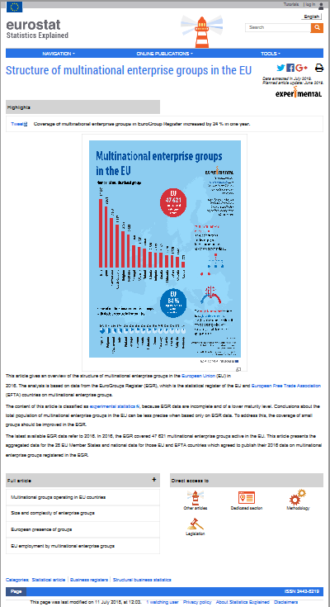
EGR dissemination article (2)
Eurostat published one statistical article on MNE groups as experimental statistics
  The article on the groups can be found under the Eurostat Statistics Explained website
  The first article was published with 2015 data in 01/2018
  It was replaced with 2016 data in 07/2018
  Yearly updates are planned as EGR is producing yearly frames

Slide 9
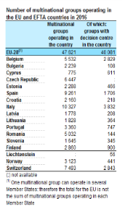
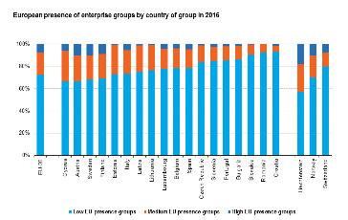
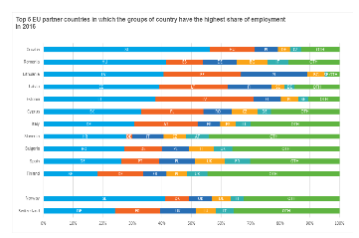
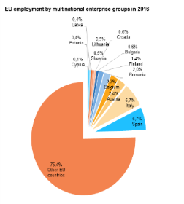
EGR dissemination article (3)
The data tables are directly extracted from the EGR
  No other data sources are used
EU-28 aggregates are always published
Country data are only published in the article where the NSIs agreed to present the data of their groups

Slide 10
  Dissemination population (1)
The EGR dissemination article only presents a subpopulation of the yearly EGR frames
Only the active groups are selected from EGR
  Groups, which have employees in their enterprises in two or more countries, at least one of them in the EU
  43% of the 111,508 EGR groups of reference year 2016 were considered as active MNE group
  57% of the EGR groups did not match the active MNE group definition

Slide 11
  Dissemination population (2)
Groups in the EGR 2016 frame by activity status

Slide 12
  Dissemination population (3)
Large number of EGR groups cover only legal units (companies), no enterprises (statistical representation of companies) in one or more countries
  The legal unit in one country is empty or dormant
In other cases the enterprises exist in other countries and were delivered to EGR, but they have 0 employment or employment data are missing
  Missing employment data play a major role not disseminating large number of EGR groups
  Eurostat will put an emphasis on this variable in the EGR process

Slide 13
  Conclusions and way forward (1)
Eurostat and the NSIs will continue working on the EGR, including the dissemination
  Analysing and improving EGR coverage and data quality
  Collecting missing relationships aiming to have a complete picture of the EU part of the groups
  Collecting missing employment values and developing estimation methods for this variable
  Performing projects aiming to retrieve more publicly available data (e.g. web-scraping)
  Analysing user feedback and enriching output tables

Slide 14
  Conclusions and way forward (2)
The EGR is a very rich data source
Eurostat and the NSIs are continuously working to improve its quality
Having sufficient quality level in the future, the EGR can be the source of very relevant and valuable European official statistics on MNE groups and their affiliates
Eurostat aims to switch from production and dissemination of experimental statistics based on EGR data to European official statistics

Slide 15
  Thank you!
Questions
Contact:
  ESTAT-EGR@ec.europa.eu

