Slide 1
Session 7 – Eurostat 2017 SBR User Survey
26th Meeting of the Wiesbaden Group on Business Registers
24-27 September 2018

Slide 2
Content
1. Eurostat SBR Data Quality Programme
2. Eurostat 2017 SBR user survey
Objectives
Survey design and data collection
Results for national SBR
Results for the EuroGroups Register (EGR)
3. SBR quality targets
4. Conclusion

Slide 3
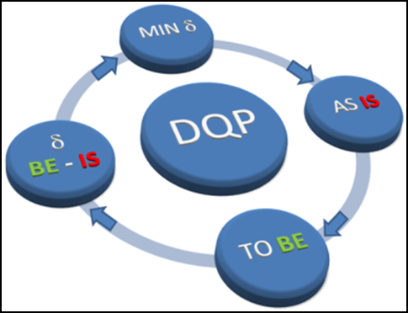
1. Eurostat SBR Data Quality Program
(A) Quality reporting
As-Is
(B) Quality targets
To-Be
(C) Quality assessment
Gap To-Be – As-Is
(D) Quality improvement
Reducing the Gap

Slide 4
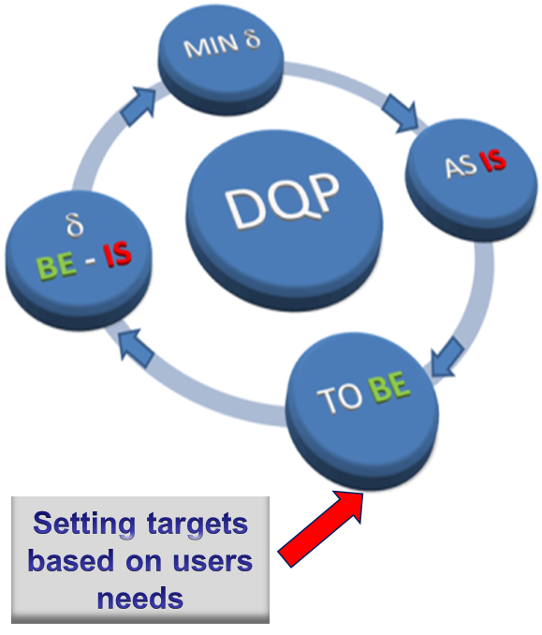
2. Eurostat SBR user survey (1)
Main goal - to assess gap between information available in SBR and information needed by users
Launched in April 2017, as part of DQP "TO BE" component
Survey addressed current and potential SBR users (NSBR and EGR) at NSIs
Results were used to define new quality targets for SBR in the ESS

Slide 5
Eurostat SBR user survey (2)
Survey design and data collection
Eurostat – in cooperation with the EU Member States – elaborated survey methodology
Two questionnaires were designed (NSBR and EGR)
EU Survey - using online survey management tool
Secured by European Commission Authentication Service (ECAS)
Coordinated by SBR correspondents in the EU Member States
Eurostat summarised survey results for ESS

Slide 6
Eurostat SBR user survey (3)
Main outcome
339 users of national SBRs and 109 EGR users were consulted
Responses were provided by 25 EU countries and 2 EFTA countries
About 10 national SBR users and 5 EGR users per country completed the survey
90% of survey respondents regularly use the NSBR and in production of statistics
36% of EGR respondents reported regular use of the EGR in production of statistics

Slide 7
Eurostat SBR user survey (4)
Results for national SBR
SBR information mainly used in Business statistics and Macroeconomics accounts
Legal unit, Local unit and Enterprise information is used in the regular statistical production
Enterprise groups information is not much used in regular statistical production at NSIs

Slide 8
Eurostat SBR user survey (5)
Results for national SBR
Legal unit:
SBR identification and demographic characteristics are regularly used in statistical production
Demographic characteristic "legal form" is highly relevant
Information on linked registers is used mainly with reference to associated registers, in which the legal unit is recorded
Local unit:
Identification characteristics are highly relevant to users
The most often used economic characteristics: principal activity code at NACE 4-digit level, number of persons employed, number of employees and geographical location code

Slide 9
Eurostat SBR user survey (6)
Results for national SBR
Enterprise:
The most used identification characteristics are enterprise identity number and name
All demographic characteristics are used
The most used economic characteristics are main activity code at NACE 4-digit level, number of persons employed, number of employees and turnover
Enterprise group:
The major relevant identification characteristics are ID number and name of EG.
The major relevant economic characteristics are principal activity code at NACE 2-digit level and number of persons employed in the group

Slide 10
Eurostat SBR user survey (7)
Results for national SBR
Purposes of use:
Mainly for statistical analyses/calculation/summing up, identification and delineation of units, microdata linking and sample frame with stratification
Broad range of other purposes, including: profiling, customised research, source of definition of weightings, data validation, identification of units and monitoring of demographic characteristics, validation and verification of annual national accounts supply-use tables, compiling TEC statistics (trade by enterprise characteristics), classifying foreign direct investment (FDI) by economic activity, etc.

Slide 11
Eurostat SBR user survey (8)
Results for national SBR
Shortcomings:
Regular users of national SBR specified some serious and manageable shortcomings with regard to users' needs
Most of the shortcomings are indicated as manageable by national SBR respondents
Most of the serious shortcomings are related to national SBR units, characteristics, coverage and timeliness
(39% - missing characteristics, 13% - units and
10% - coverage and timeliness)

Slide 12
Eurostat SBR user survey (9)
Results for the EuroGroups Register
EGR information is mainly used in Business statistics and Globalisation
Most of the legal unit characteristics are used in statistics production
Relevant characteristics for enterprises and multinational enterprise groups are used in the regular statistical production
Most of the NSIs use EGR information for identification and delineation of units

Slide 13
Eurostat SBR user survey (10)
Results for the EuroGroups Register
Shortcomings:
Regular users of EGR information specified some shortcomings with regard to their needs (in terms of units, coverage, missing characteristics, timeliness, frequency and others issues)
Most of the indicated shortcomings are related to EGR coverage and timeliness
(39% - EGR coverage and 22% - EGR timeliness)

Slide 14
3. SBR quality targets (1)
SBR Data Quality Programme
Set quality targets for the national SBR and EGR
Compliance targets – minimum quality targets that shall be met to be compliant to the BR Regulation
Extended targets - could be met by Member States to improve the national SBRs quality

Slide 15
3. SBR quality targets (2)
Eurostat 2017 SBR user survey
Used to define new quality targets for national SBR and EGR
SBR quality targets are used in the annual quality assessment, done by Eurostat
National SBR and EGR follow the annual SBR data quality programme to improve gradually the SBR quality in a standardised way

Slide 16
4. Conclusion
Eurostat 2017 SBR user survey
Provided useful information on the degree the current user needs are met – with regard to content, coverage, accuracy, timeliness, etc.
Outline directions for improvement and quality targets
Eurostat will regularly use SBR user survey in the future
Next SBR survey is planned for 2020

Slide 17
Thank you!
Questions
Contact:
Iliyana.Iskrenova@ec.europa.eu
Zsolt.Volfinger@ec.europa.eu
Eurostat, Unit G3

