Slide 1
New data sources for the EuroGroups Register
David Broska, Dimitar Nenkov (Eurostat)
  Session 5 - New Data Sources
  26th Meeting of the Wiesbaden Group on Business Registers
  Neuchâtel, 24-27 September 2018

Slide 2
  Overview
EuroGroups Register (EGR)
DBpedia
Feasibility study objectives
Results for proof of concept
  Coverage
  Completeness
  Accuracy
  Timeliness
Conclusion

Slide 3
What is EGR?
Eurostat governs the EuroGroups Register (EGR)
Statistical business register of multinational enterprise groups in the EU and EFTA countries
    Coverage: multinational groups present in the EU, their constituent enterprises and legal units
    The EGR process is in operation since 2009
  Restricted use in national statistical offices and national central banks of the EU and EFTA countries
  For statistical use only

Slide 4
Problem statement
In the EGR the EU and EFTA parts of the groups are well-covered
There are missing data for units outside of the EU and EFTA as well as for attributes on the group level
Web crawling and different open data projects are seen as further opportunities to increase the quality of the EGR, its completeness and accuracy
  Possible data source of group attributes can be the Wikipedia company profiles

Slide 5
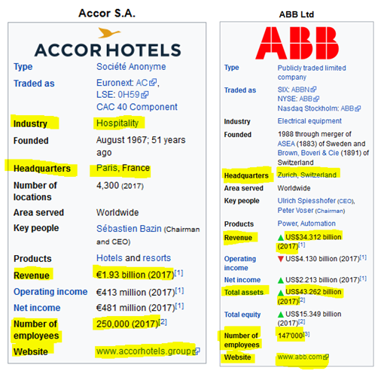
  Wikipedia company profiles

Slide 6

  DBpedia
DBpedia is a project that extracts structured data from Wikipedia in order to make it publicly available in a format that overcomes limitations of the latter
  Execute sophisticated queries against Wikipedia data
  Link different data sets to Wikipedia data

Slide 7
  Feasibility study objectives
  The project goal was to create an interface that handles a list of group names and returns a list of results with detailed information on those enterprise groups
  The contractor, Leipzig University, was provided with a population of 73 group names in order to design an interface that fetches search results from DBpedia

Slide 8
  Proof of Concept results
  This Proof of Concept focused on validating the following indicators:
  Coverage – number of successfully matched enterprise group names
  Completeness – number of received values for the different attributes
  Accuracy – quality of the returned values when compared to annual report data
  Timeliness – availability of data for certain reference period based on EGR cycle

Slide 9
  Coverage - reference year 2016
  In order to prove the feasibility of retrieving data from DBpedia, a sample of 73 MNE groups was selected addressing groups size and geographical location diversity
  These groups were taken from a data set received from commercial data source Dun & Bradstreet covering a selection of 3000 groups
  70 of those groups could be found in Dbpedia, for those 70 groups at least some information could be retrieved

Slide 10
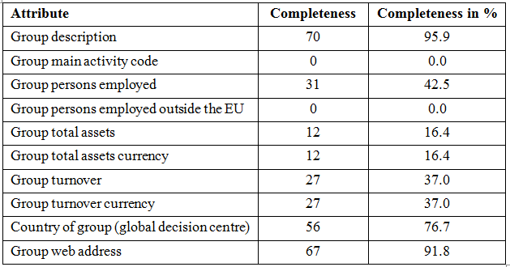
  Completeness
  In contrast to the high percentage of enterprise groups matched in DBpedia, the number of retrieved attributes for year 2016 is less promising

Slide 11
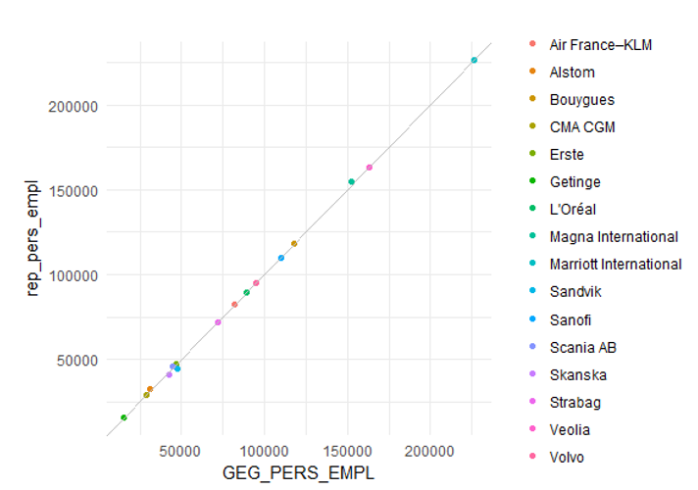
  Accuracy: Employment data from DBpedia (GEG) and from annual reports (rep)

Slide 12
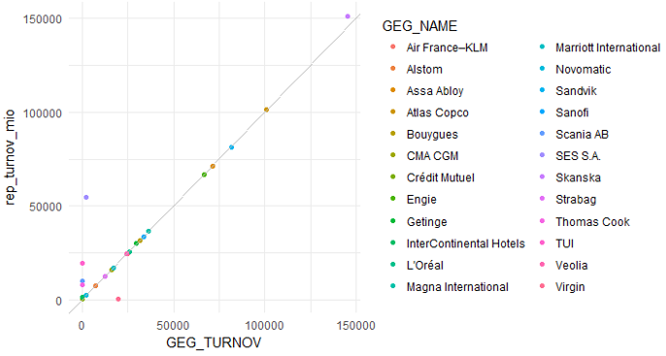
  Accuracy: Turnover data from DBpedia (GEG) and from annual reports (rep)

Slide 13
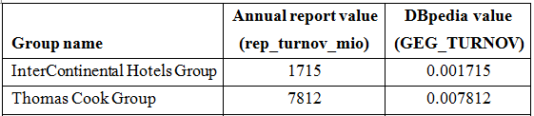
  Accuracy: Turnover data
  Although the overall accuracy of values is remarkable, there are Dbpedia values close to 0
    This problem occurs when a complex mixture of comma, point and currency is given
    In fact the modifiers (million, billion etc.) are not interpreted correctly
  It seems that there will be no 100% correct extractions for every single case in DBpedia

Slide 14
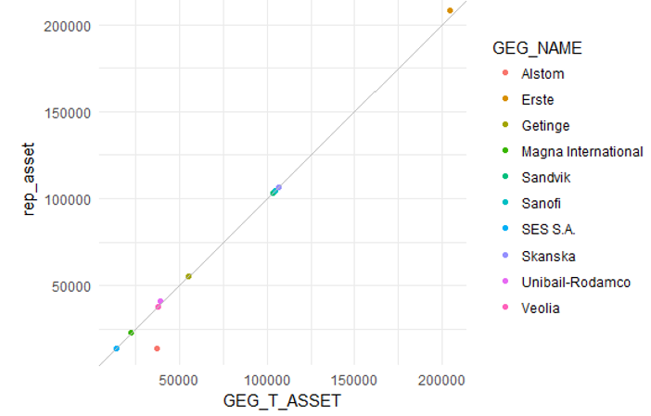
  Accuracy: total assets data from DBpedia (GEG) and from annual reports (rep)

Slide 15
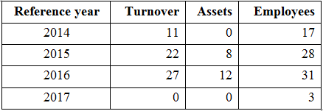
  Timeliness: Coverage 2014-2017
The DBpedia interface includes a historical mode that allows to retrieve data on groups even if Wikipedia data have already been updated with new data
Due to the delay with which the EGR provides data on enterprise groups this feature is essential
Number of retrieved values from DBpedia

Slide 16
  Conclusion
The results from the feasibility study show that a complete automatization was not achieved
The exported data would require further analysis and human intervention before the data are used
The highest percentage of coverage for persons employed is still below 50%
  Persons employed 42.5% , turnover 37.0%, assets 16.4%
The retrieved data on the three parameters showed high accuracy when compared to the figures published by the groups on their websites

Slide 17
  Thank you!
Questions
Contact:
  ESTAT-EGR@ec.europa.eu

