Slide 1
Developing an Integrated Point of Contact Coding Service for Industry Classification
26th Meeting of the Wiesbaden Group on Business Registers

Slide 2
Introduction
This presentation provides an overview of how a risk to Australian Bureau of Statistics (ABS) industry data was mitigated through the development and implementation of a coding solution hosted by the ABS and made available to all organisations facilitating the business registration services.

Slide 3
Overview
Business registration in Australia
Australian Bureau of Statistics Business Register
Australian and New Zealand Standard Industrial Classification
Business industry data
Digital Transformation Agenda and new business registration services
Risks associated with new business registration services
Solution – integrated point of contact coding service for industry classification

Slide 4

Business Registration in Australia
All Australian businesses are required to register for an Australian Business Number (ABN).
Business registrations are facilitated through a single online portal.
Registration data feeds into the Australian Business Register (ABR).
The ABR is administered by the Australian Taxation Office.

Slide 5

Australian Bureau of Statistics Business Register
The ABR is the primary source of businesses for the Australian Bureau of Statistics (ABS) Business Register.
ABS Business Register is the basis for the majority of ABS business survey frames and the business demography program.
Industry activity data is collected as part of business registrations.
The quality of industry activity data is critical.

Slide 6

Australian and New Zealand Standard Industrial Classification
Australian and New Zealand Standard Industrial Classification (ANZSIC) is the standard classification used for classifying statistical units by industry.
ANZSIC is a core variable on the ABS Business Register.
ANZSIC is used for financial, administrative, analytical and statistical purposes.

Slide 7
Australian and New Zealand Standard Industrial Classification
ANZSIC Coding Example
A business that manufactures alcoholic beer is classified the following way using ANZSIC.

Slide 8

How is industry activity data collected?
Registrants are required to self-code their intended industry activity at the point of registration.
An ANZSIC point of contact coder (PoCC) is called upon during the registration process.
This PoCC is owned and maintained by the ABR.
The PoCC assists the registrant in selecting the most appropriate description of their intended business activity.

Slide 9
How does a PoCC work?
A PoCC uses an index file with a list of pre-determined text responses.
Each response has a corresponding ANZSIC code.
Receives input through a user interface and searches the index file.
Using inbuilt logic, it returns matches which are presented to the registrant.
The registrant selects the most appropriate description and an ANZSIC code is allocated to the registration.

Slide 10
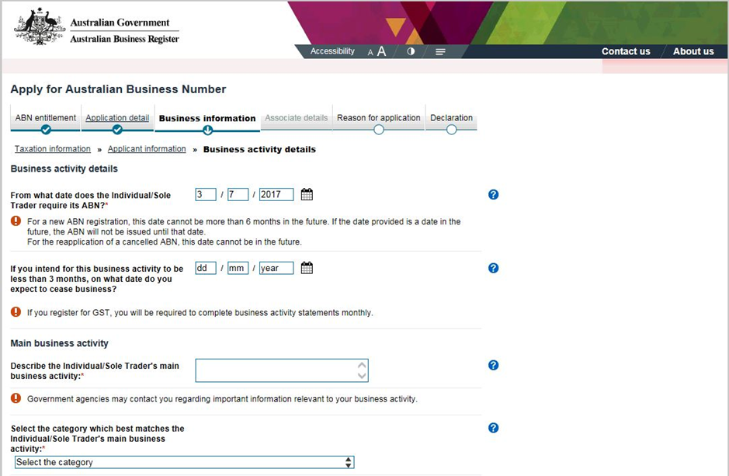

ABN Online Registration using the ABR Portal

Slide 11
ABN Online Registration using the ABR Portal
Registrants describe their business activity here

Slide 12
ABN Online Registration using the ABR Portal
Registrants describe their business activity here
The PoCC returns description matches associated with ANZSIC codes here

Slide 13
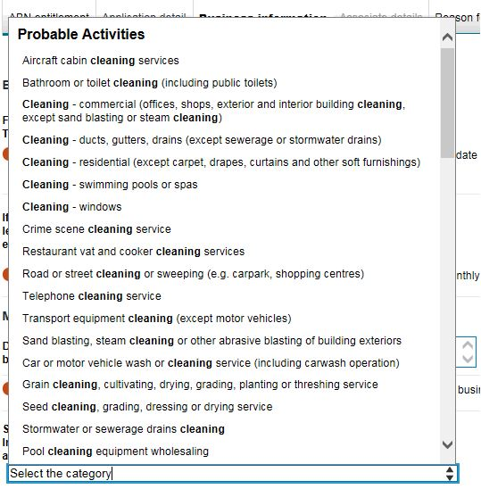
ABN Online Registration using the ABR Portal

Slide 14

ABN Online Registration using the ABR Portal
Data Flow to ABS

Slide 15
Digital Transformation Agenda
The Australian Government is investing $AU254.7 million in the Digital Transformation Agenda
  Will drive innovation
  Provide better access government services
  Includes a streamlined Business Registration Service
  An online portal to simplify business registration and licensing services.

Slide 16
Digital Transformation Agenda
Businesses will be able to apply for multiple business licensing and tax registrations at the same time.
The service:
  is simple to use and provides all relevant information clearly in one place
  allows applicants to save and resume an application
  checks the availability of a proposed business or company name, and
  includes customer support.

Slide 17





Digital Transformation Agenda
Business interactions with the new online portal
Register business
Run business
New Online Portal
Modify business
End business

Slide 18

Impact of the Digital transformation Agenda
Multiple business registration services.
The existing ABR ANZSIC POCC cannot be accessed by any new business registration providers.
Multiple business registration portals means multiple PoCCs.
PoCCs will be independently owned and maintained.

Slide 19
Potential Data Flow to the ABS

Slide 20
Risks to the Quality of Industry Data
Multiple PoCCs used in alternate online ABN registration portals will bring the following risks:
  Accuracy of industry coding
  Maintenance of industry coders
  Use of industry data

Slide 21

ABS ANZSIC Point of Contact Coder
To mitigate the risks, the ABS developed its own ANZSIC PoCC.
It uses a Windows application developed by Statistics Canada called G-Code.
It’s hosted by the ABS and is accessible via an API.
It facilitates both whole-of-government and external use.
Moved into production in May 2018

Slide 22
ABS ANZSIC Point of Contact Coder
The ABS ANZSIC PoCC is compulsory for all online registration portals.
One solution for all portals ensures consistency in outputs.
The ABS has control of maintenance.
Data quality of industry data remains high.

Slide 23
New data Flow to the ABS

Slide 24

Quality Assurance
Success is dependent on the quality of ANZSIC codes allocated to business.
Ongoing monitoring is critical to ensure data quality remains at optimum levels.
ABS ANZSIC PoCC Quality Assurance Strategy
  measures PoCC performance over time
  determines whether the quality of industry data is fit for purpose
  determines requirements for PoCC maintenance

Slide 25

Conclusion
The ABS responded to a change in government policy
The solution developed mitigated risks to industry data
It can easily be incorporated into business applications
As co-custodian of ANZSIC, changes to the classification will be reflected in the PoCC
Costs of maintenance outweighed by quality economic statistics
Can be adapted for other classifications

Slide 26
Questions?

