Slide 1
New data sources – what do we do in Denmark
Presented at the Wiesbaden Group meeting 2018
Steen Eiberg Jørgensen, SEJ@DST.dk
Statistics Denmark

Slide 2
Why – business case
Focus on reducing the workload
From the government
Why is Statistics Denmark involved?
Faster data
From the industry organisations
From the enterprises
Improved quality
Reduced data processing costs
Higher response rates
Larger samples and more data

Slide 3
Data collection - Need for change: Reduced workload + More efficient production + New statistical products
Collect Transfer Share Use
Up till now: Digitalise
Data Collection (“1:1”)
From paper surveys
to digital surveys and
1:1 System-to-system
“Same”
Adapted production systems
New tools and data collection systems
New digital functionality for reduced 1:1 workload
Legislation on new modes
for same tasks and same units
The way ahead:
Transform Data Collection (“N:M”)
Find relevant data where it is - and use it, all?
Flexibility and adaptability
Fast-paced technological development and new sources
Voluntary win-win partnerships vs. slow-paced legislation
Diverse coverage vs. conventional sampling
Maximise
Automation – if the business case is good
Key partnerships - for coverage, stability and few systems
Generic standards and systems across providers - and NSIs?
For receiving and storing data
For data processing: Machine learning, Big data analysis
For documenting data compiled from diverse sources
Flexible use of data
Prefill fields > Shorten questionnaires > Replace surveys
Use “extra” data for new processes and new products

Slide 4
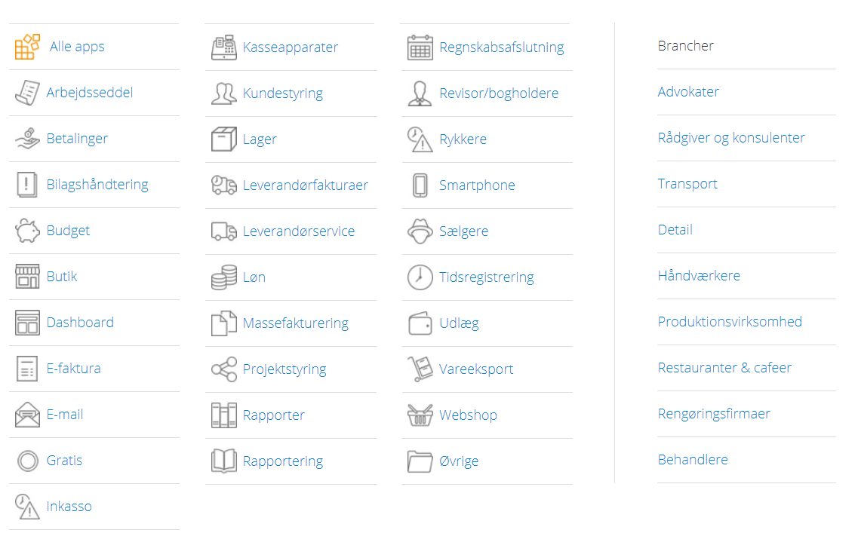
Digitisation trends
Digital transformation
Systems go online and become standardised
Data is born digital, e.g. on home pages
Data is processed digitally, e.g. via apps
Data is stored in the cloud and shared between systems
The situation for newly established SMEs
Operating a business should be easy
No interest in administrative tasks
Data is willingly shared if it eliminates an administrative task

Slide 5
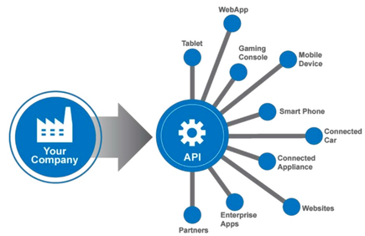
New digital enterprises
Enterprises are started digitally
Create a company in five minutes
Standard articles of association, standard charts of accounts, NemID
And continue to operate digitally
300,000 active enterprises in Denmark
200,000 use online accounting systems – typically SMEs
Five significant operators in the market
One dominant operator
The development creates automation opportunities

Slide 6
Levels of automation
Level 5
A central supplier provides the NSI with comprehensive data from “all” enterprises
Level 5: Digital partnerships with central suppliers of data – structured or unstructured
Level 4
ERP systems are adapted to automatically transfer data to the NSI.
Data is approved by the enterprise.
Level 4: Automatic report
Level 3
ERP systems are adapted
to facilitate transfer of data to the NSI.
Data is approved by the enterprise.
Levels 2-3:
Semi-automatic report
Level 2
An app exports data from internal business systems.
Data is validated and approved by the enterprise.
Level 1: Manual file upload
Level 1
The enterprise exports data from the internal business system.
The data file is uploaded with/without validation at source.
Baseline
Enterprise enters data into digital questionnaire or app questionnaire.
Data validated and approved by the enterprise.

Slide 7
Status in Statistics Denmark
Use of big data
Accounting statistics – XBRL data
Statistics on agriculture – satellite data
Library statistics
Tests and voluntary agreements on data deliveries
Provider of accounting systems
Data on transport and goods on vehicle
Data on farming, e.g. harvest, forest areas and pigs
Monthly turnover in retail businesses

Slide 8
Clarification issues
How can we automate?
Do external suppliers take an interest in contributing to and (co-)financing the automation?
Is there great diversity in the (online) systems applied by the enterprises?
Should enterprises subject to reporting duty give the central operator power of attorney authorising him to make the reporting?
Does the law authorise dowloading of data from central operators?
Are central operators allowed to submit information to SD on behalf of enterprises that are not subject to a reporting duty?
Are the central operators willing to enter into voluntary partnerships?

Slide 9
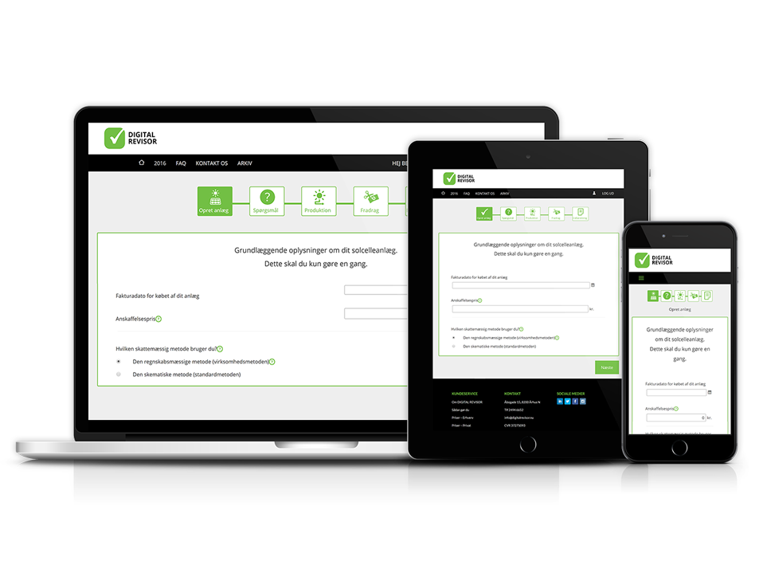
Consequences of automation
Risks
Higher degree of customisation
Raw data may be less accurate
Reduced quality assurance in the reporting situation
Opportunities
Increased amounts of data reduce the requirement for accuracy
Machine learning can patch up incomplete information
Improved dialogue with reporting offices due to reduced workload

Slide 10
The way forward
Externally:
Automatic business reporting
App for the retail sales from Economics (an online-based accounting system)
Data on harvest etc. from SEGES
Data on pigs from Cloudfarms
Data on transport of goods by lorry from Tungvognsspecialisten (a heavy goods vehicle specialist advisor)
Felling data from Hedeselskabet (the Danish Land Development Service) etc. (or satellite data?)
Internally:
Many small “buckets”? Shared “bucket”?
Organisation
Central unit/
central or decentralised competencies?
Data secure processes and complete overview
Externally: Active search for potential partners using selected statistics or data
Internally: Inspirational catalogue about the use of new data types
Prefilling
Troubleshooting
Statistics
A (large) “bucket” for storage
Notes:
There is a lot of testing going on in SD and some of them is overlapping others.
We search for aktive partners to promote the process.
We are currently working with 6 external partners + Danish Business Authority and Nordic Smart Government.
Common for the projects, is that we go to focal companies who already have data, instead of individual companies.
The organization of the work is not fully in place and in some areas is very decentralized, but we use a lot of effort to share knowledge, so that we are going in the same direction, if not always in pace.

Slide 11
Why do they want to join - Libraries?
LIB 1
LIB 2
LIB 3
LIB 4
LIB N
SD credibility as a data processor
Reduced workload
Access to own data
Common library system
Management information
Statistics Denmark
The Danish Library Association
official statistics
Tables return to LIB 1, 2, ..
Lending
Public zone
E-books etc.
movies
Metadata
Danish library service

Slide 12
How they joined: Live music
 | 1st meeting | 2nd meeting | 3rd meeting | 4th meeting
Purpose and content | Presentation and discussion of wishes | Discussion of draft | Presentation of purpose and content
Statistics Denmark’s registers | Discussion of potential registers | Discussion of drafted tables | Presentation of statistics tables
External sources |  |  | Discussion of drafted tables | Presentation of statistics tables
Method memo |  |  |  | Presentation of complete method memo
Notes:
How do we make a deal with a ”customer” about a desired dataproduct ?

Slide 13
Steen Eiberg Jørgensen, SEJ@DST.dk
Tak
спасибо
Gracias
Merci
Dank
Thanks
благодаря
Grazie
მადლობა
감사
谢谢
Grazie

